Slide 1

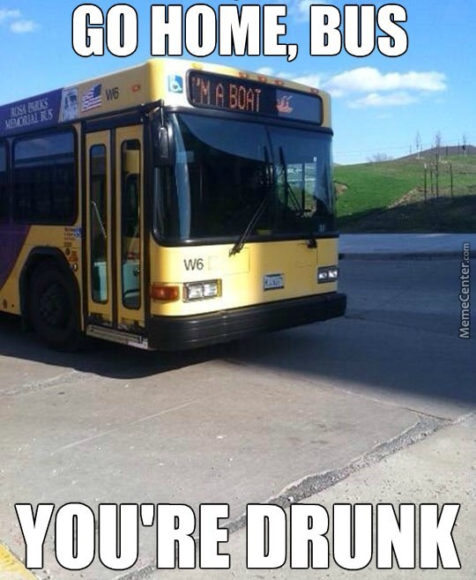
Public Transport
Team update
Dave Harrison, Public Transport Team Leader
Parish Transport Representatives – 19 March 2024

Slide 2
Summary
Budget update
Contracts recently awarded
Future plans
Infrastructure

Slide 3
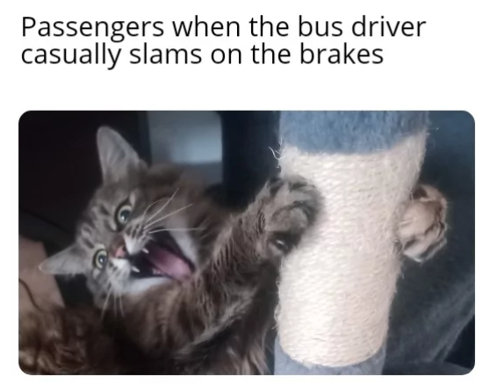
What’s been going on
2024/25 budget update:
  Reduction in rural & community transport budget, but no impact on delivery
  Increase in ENCTS budget
  Other budgets maintained
  Amendments accepted:
    £70k for demand responsive transport feasibility study
    £150k for franchising feasibility study
Bus maps tender about to be issued

Slide 4

What’s been going on
Latest bus tender process concluded this week 🥇
New contracts:
  Banbury town network, including new service to Chalker Way
  488 and 489
  New Bicester rural services
  New Carterton – Oxford express services
  New Haddenham – Thame service (replacing current 121)

Slide 5
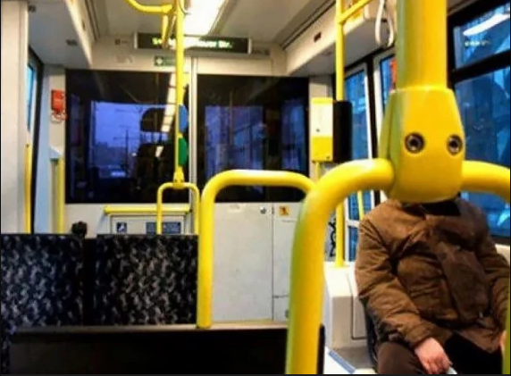
Future plans
CMD on 21 April 2024
Seeking a decision on new contracts:
  New orbital service between Redbridge, Oxford Science Park, Cowley and JR Hospital
  Improved service between Oxford North and Headington
  Continuation of Didcot – Harwell – Newbury/Wantage services

Slide 6
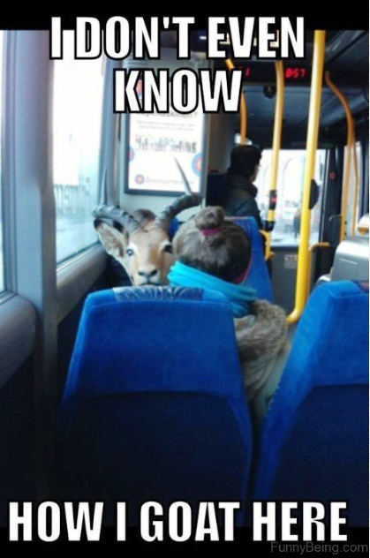
Future plans
Additional service improvements associated with traffic filter scheme:
  3A (Oxford – Littlemore – Oxford Science Park) to every 15 minutes
  5A (Oxford – Minchery Farm) to every 20 minutes
  X40 (Oxford – Reading) to every 20 minutes
Another 18 contracts extending up to a year

Slide 7
Contract list

Slide 8
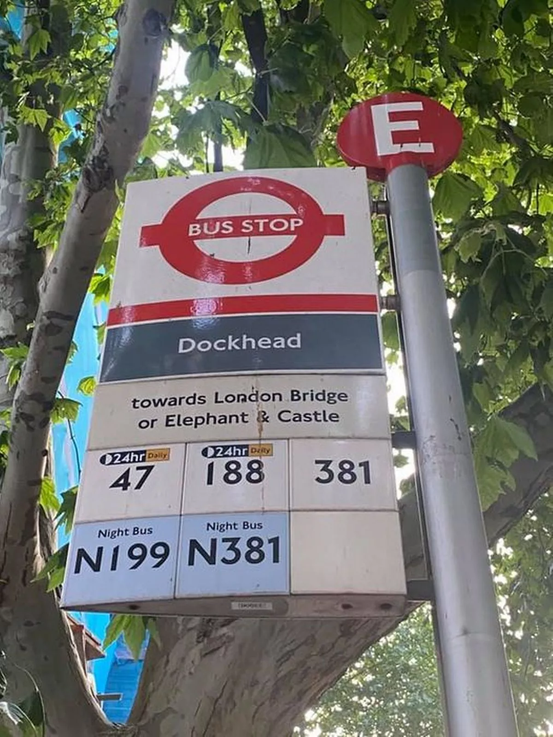
Infrastructure
£102k annual budget for bus stop maintenance
  Stop/shelter improvement and repair
  Programme to “name” all bus stops by October 2026
  Parish survey
c.£2.5m S106 funds countywide
  Developer funds for new facilities
  3 year programme being developed

Slide 9

Questions?
Dave Harrison
Public Transport Team Leader
dave.harrison@oxfordshire.gov.uk
07901 331751

