Slide 1
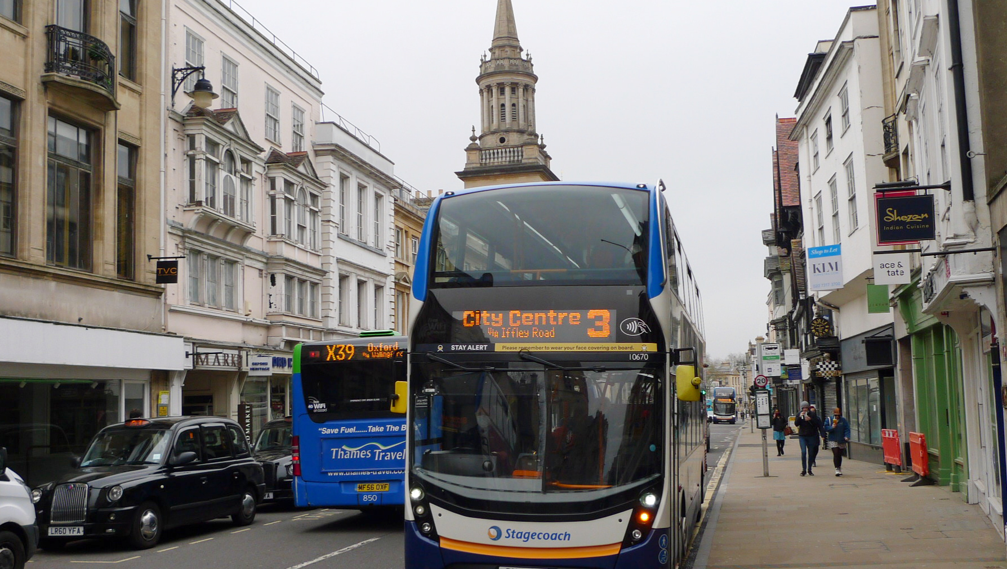
Oxfordshire Bus Service Improvement Plan (BSIP)
An Update
PTR Meet 19 Mar 24
Katharine Broomfield
Oxfordshire County Council

Slide 2
Contents
Background to the Oxfordshire BSIP
Existing bus improvement projects
What’s next?

Slide 3
1. Background to the Oxfordshire BSIP

Slide 4
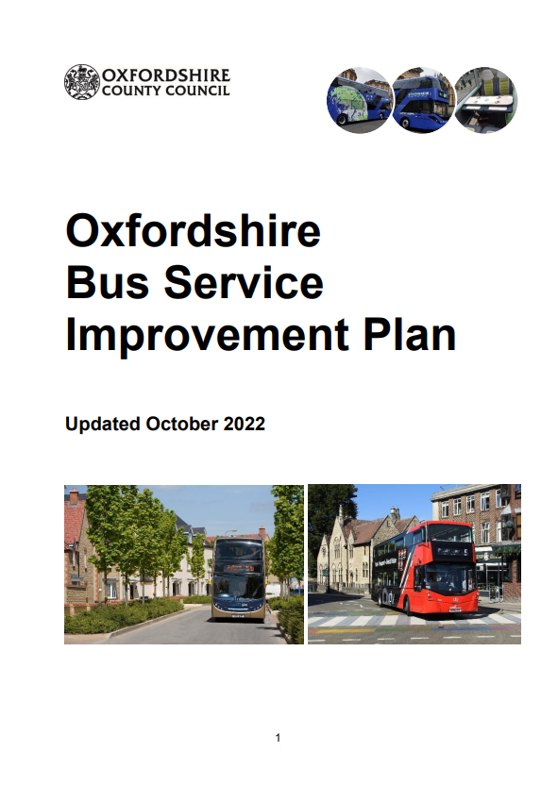


The Oxfordshire BSIP and EP
Bus Service Improvement Plan (BSIP)
High level strategy
Sets out key long-term ambitions for improving our local bus network
and how these will be achieved
To be restructured and updated in 2024
Enhanced Partnership (EP)
Outlines the commitments on both parties
Mechanism for delivery of BSIP ambitions
Set governance structure
EP documents currently being updated
Link: Bus Service Improvement Plan and Enhanced Partnership | Oxfordshire County Council

Slide 5

Timeline of key events
Launch of NBS - Mar 21
BSIP publication - Oct 21
ZEBRA bid success - Feb 22
BSIP funding allocation - Apr 22 (£12.7m)
Formation of EP - Jan 23
BSIP Phase 2 funding allocation - May 23 (£1.9m)
Deadline for delivery of funded schemes - Mar 25
Full update and restructure of the BSIP - Jun 24

Slide 6
2. Existing bus improvement projects

Slide 7

BSIP funded schemes – funding split
https://letstalk.oxfordshire.gov.uk/
4 x retained bus services, including those affected by Botley Road closure
12 x new and enhanced bus services

Slide 8
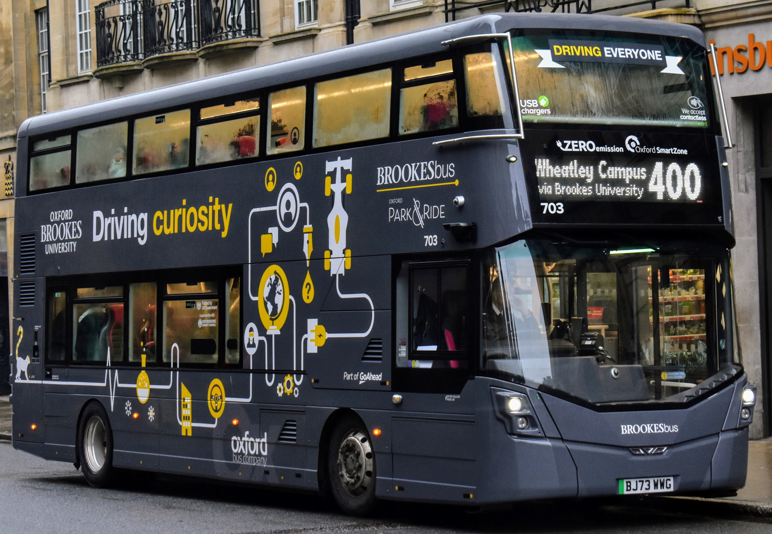
Related projects using alternative funding
159 new zero emission buses in Oxford
improved travel information
Park & Ride discounted fares
Mobility Hubs programme
eight new rural bus routes
improved bus stop infrastructure
New website for the partnership

Slide 9
3. What’s next?
and how you can help to shape plans for the next 5 years

Slide 10

What’s next?
Continue delivery of committed schemes
Bus connectivity assessment – Spring 24
Full update and restructure of the BSIP by June 24:
  Updating the baseline to 2023/24
  Setting out the improvement programme in financial year 24/25
  Getting ready for 2025 and beyond

Slide 11

How you can help to shape plans
Series of planned engagements in March and April
Feed back to us via an upcoming ‘Let’s Talk’ survey
Insights will be shared with the EP Board for consideration within the 2024 BSIP

Slide 12
Contact
bsip@oxfordshire.gov.uk

