Slide 1
Oxfordshire rail matters
PTR’s meeting 19 March 2024
Pete Brunskill MRTPI
Principal Rail Development Planner

Slide 2
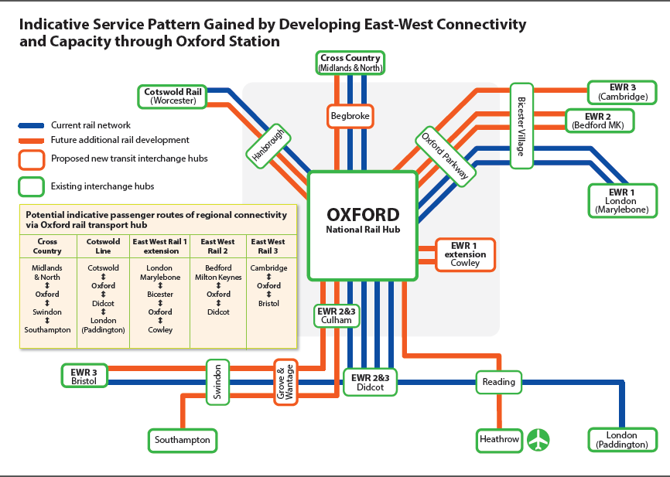
Oxfordshire’s Plan for rail
Railways are key to connecting many Oxfordshire settlements and providing excellent links to other towns and cities across the country – Oxford is at the heart of the national network
We need major capacity enhancements so that more people and goods can go by rail
De-carbonisation and climate resilience are key challenges to be addressed

Slide 3
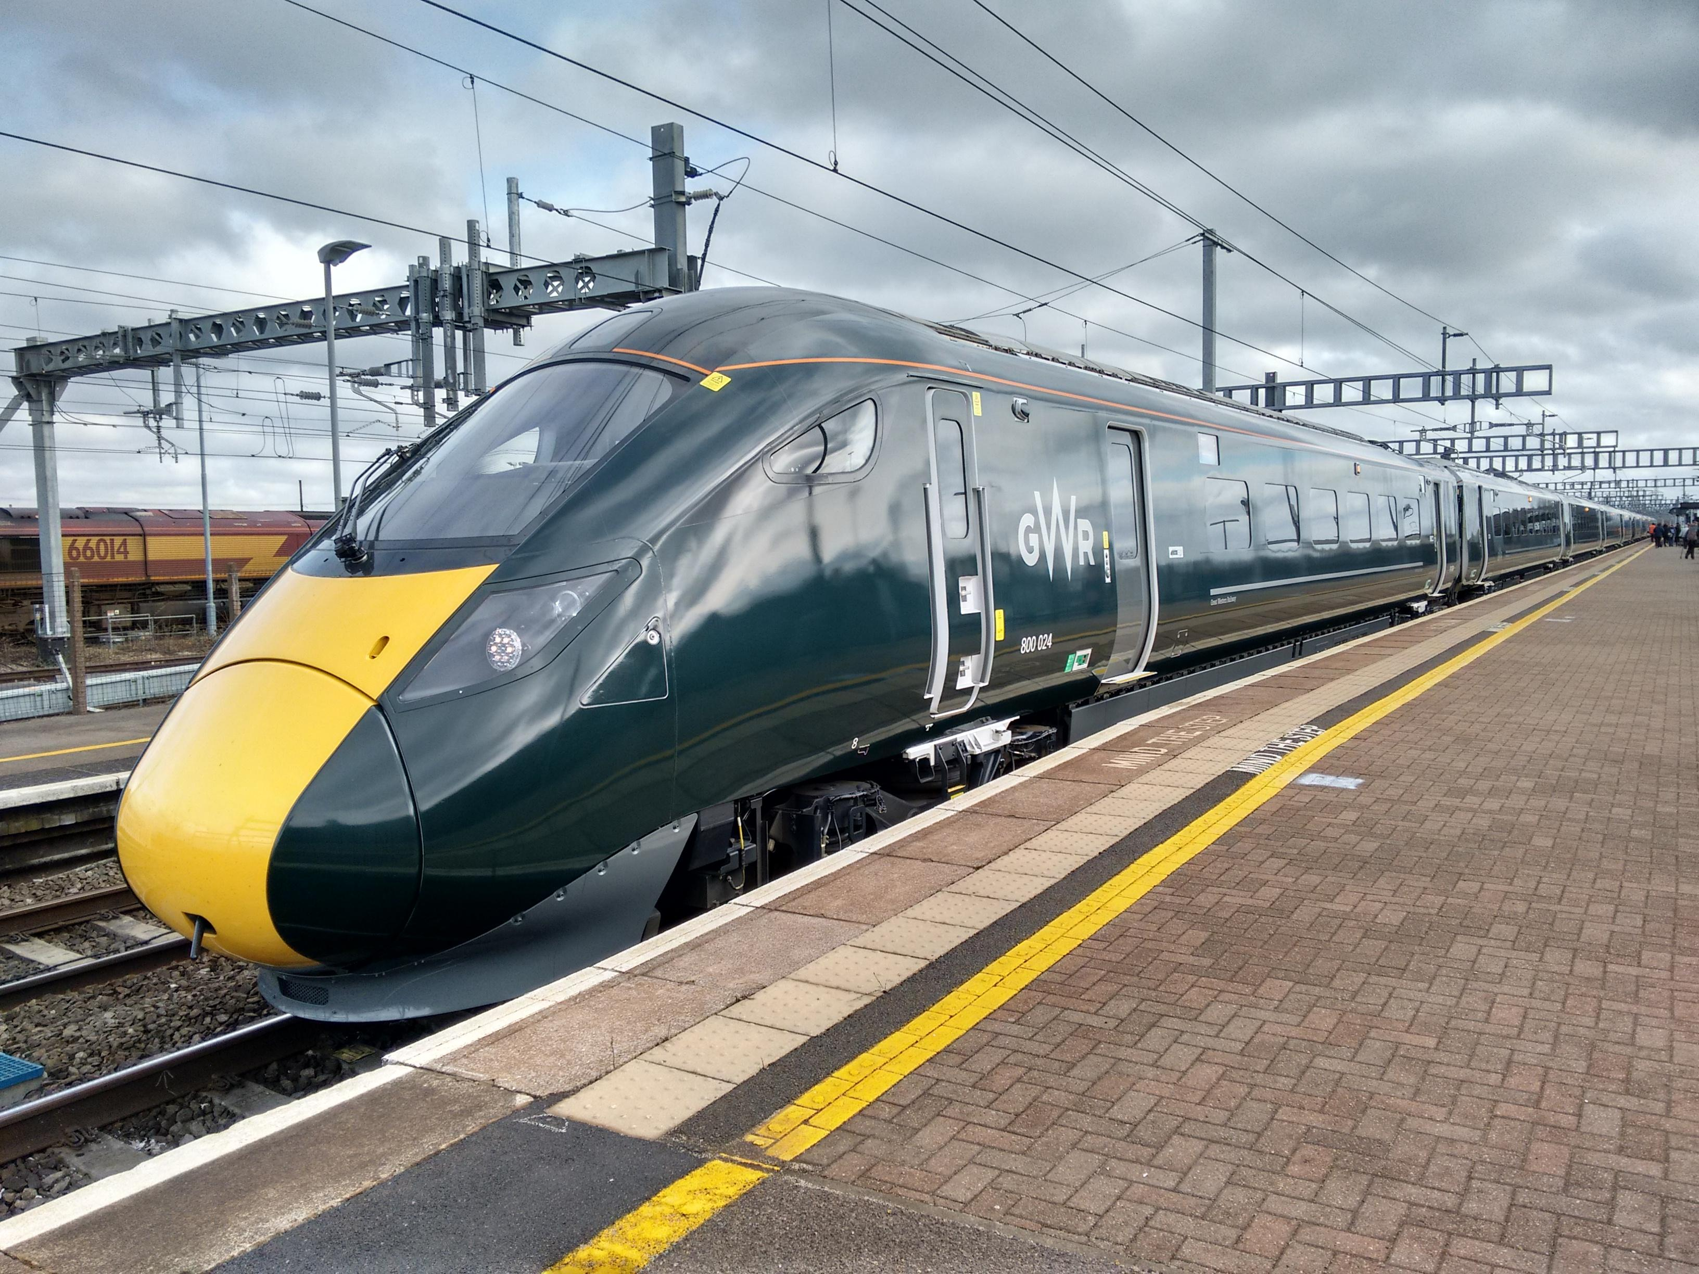
Setting the scene
The Oxfordshire Rail Corridor Study is the current plan document - approved by the County Council and the Future Oxfordshire Partnership in 2020
More journeys by rail is key to delivering our ambitious Local Transport and Connectivity Plan targets and enabling sustainable development. Dramatic reduction in car journeys, de-carbonisation/air quality, modal shift, improved accessibility/inclusivity and Vision Zero
Our desire to do more is being set out in an ambitious new OxRail 2040: Plan for Rail strategy (currently being drafted)

Slide 4
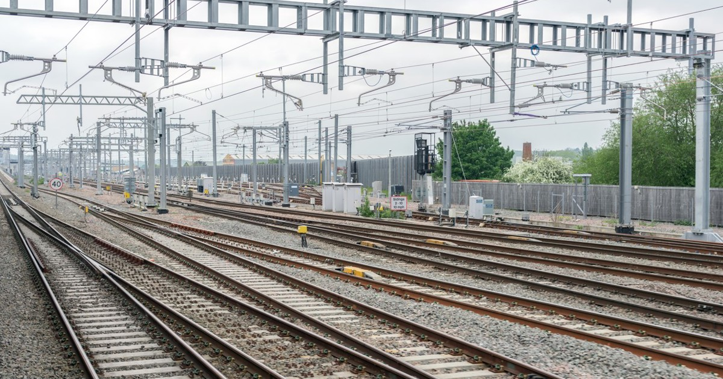
Infrastructure for growth
Didcot-Oxford (Hanborough) 25kv AC electrification – wider network benefits
Double (North Cotswold) and four-tracking (Oxford to Radley)
New, expanded and redeveloped railway stations across the County
Reduction in the number of level crossings, investment in better S&C and linespeed upgrades
Critical to design for freight growth – intermodal, aggregates, parcels

Slide 5
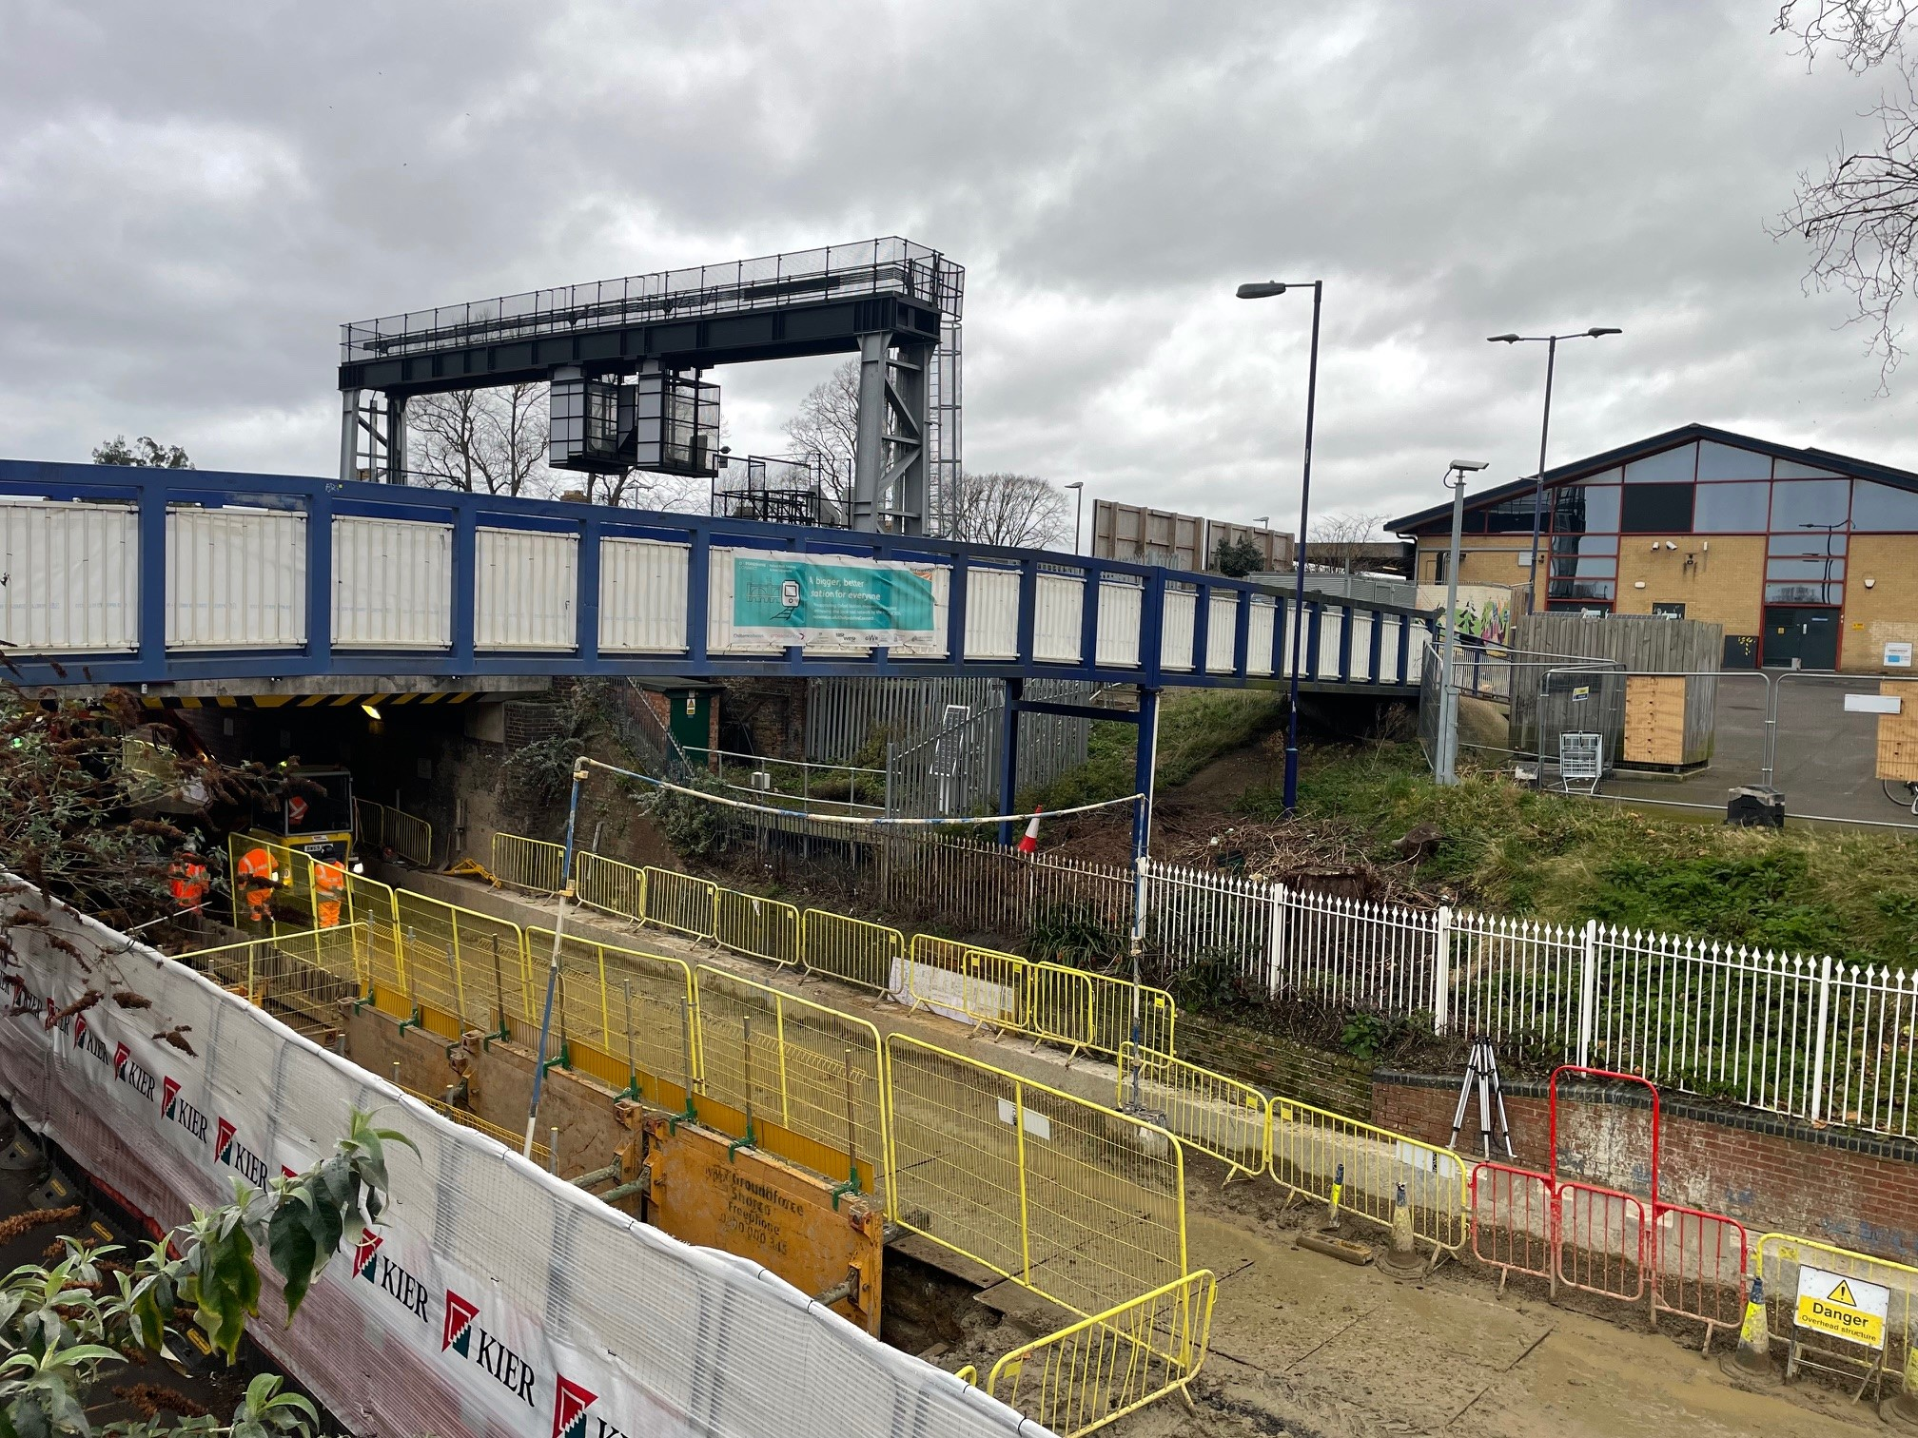
Oxford Phase 2C
Involves placing a new larger overbridge just outside the station
Creation of a new Platform 5 and Western Station entrance
Plans for a new pedestrian underpass connecting station platforms and supplementing the existing passenger footbridge
Linespeed and S&C improvements
Potential closure of three level crossings to the north of Oxford. Two proposed footbridges and a new enclosed, accessible footbridge (with lifts) at Tackley

Slide 6
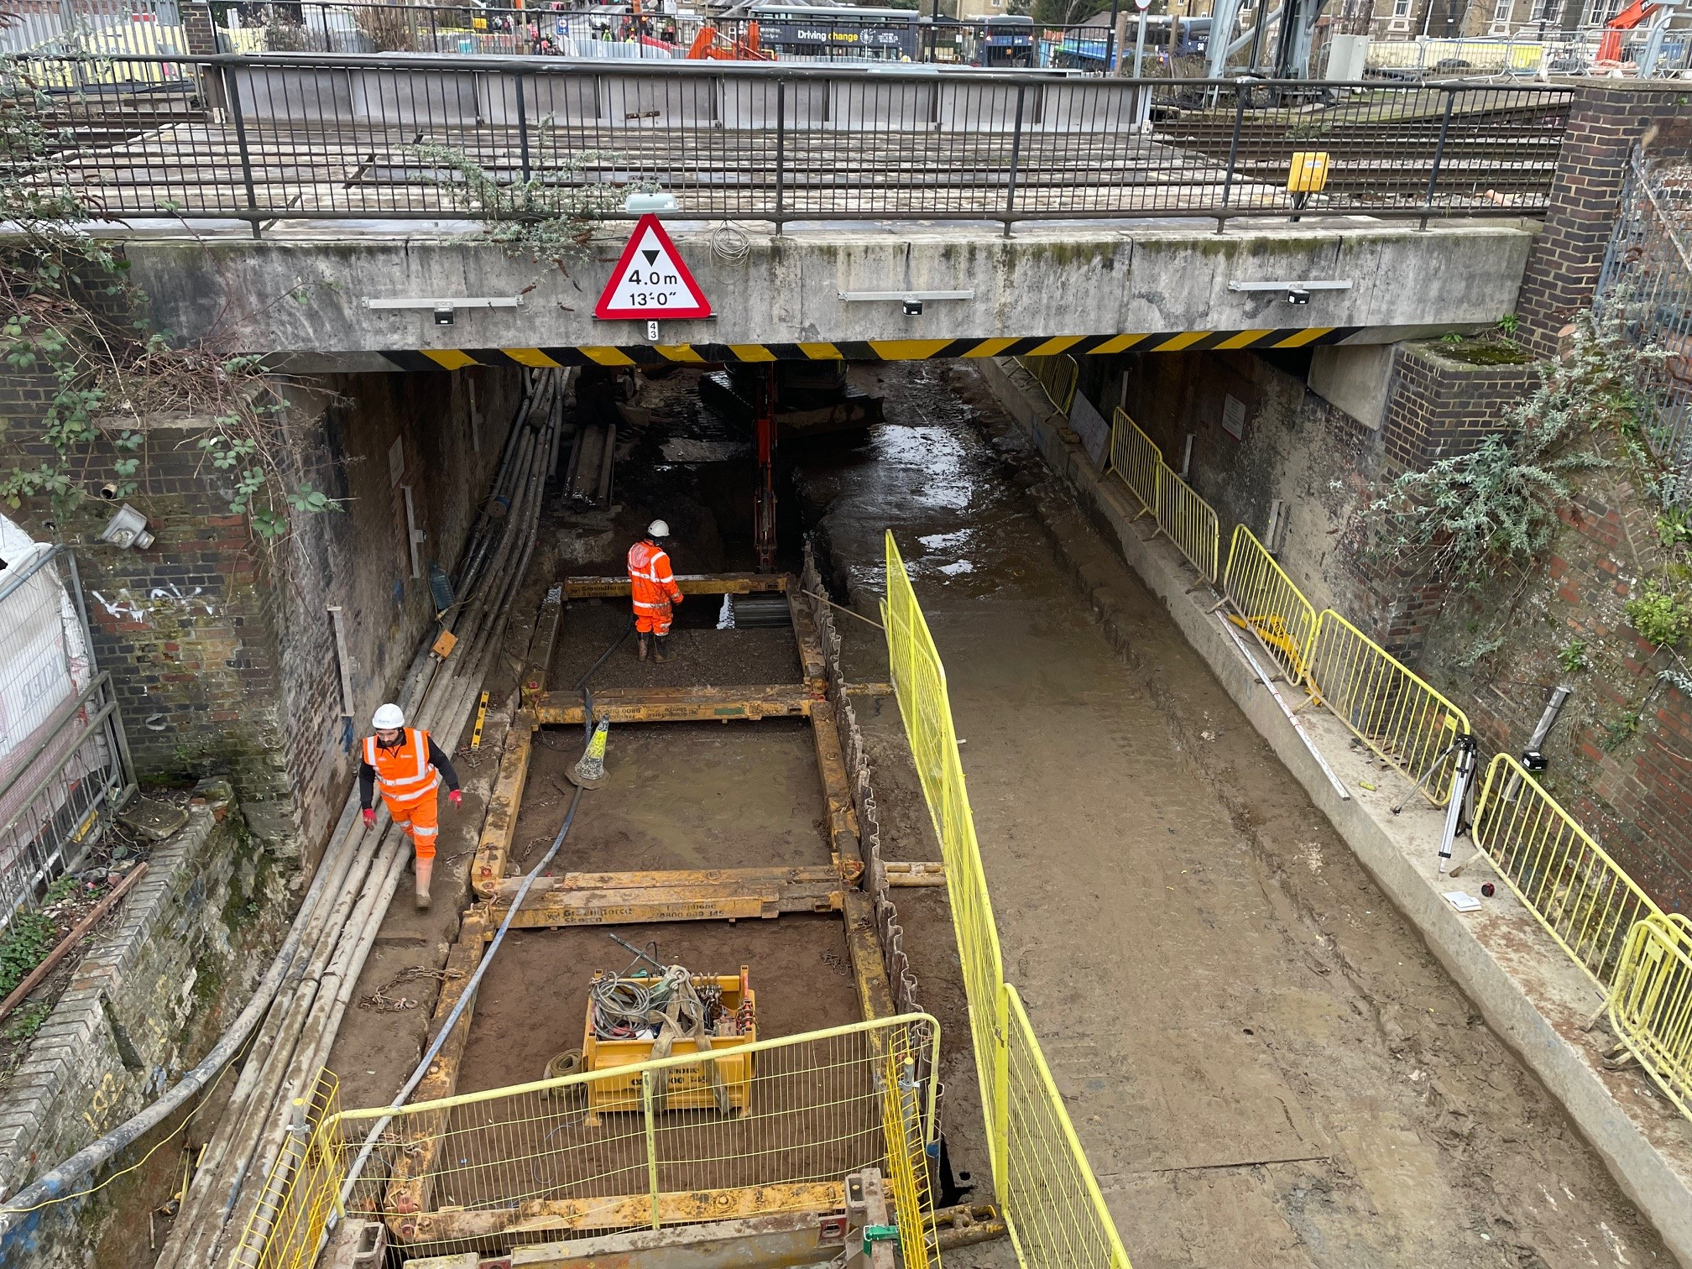
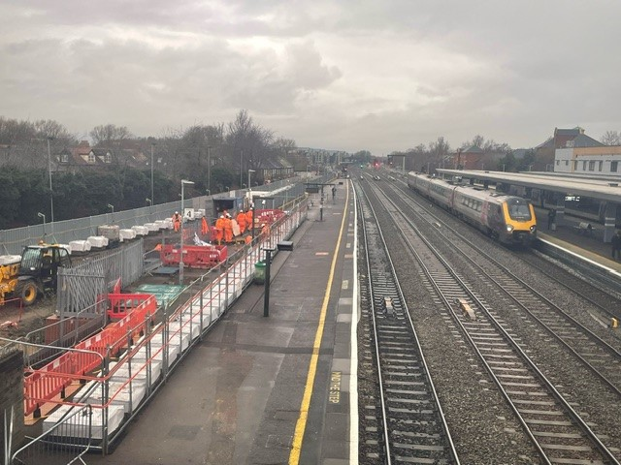
A massive engineering effort

Slide 7
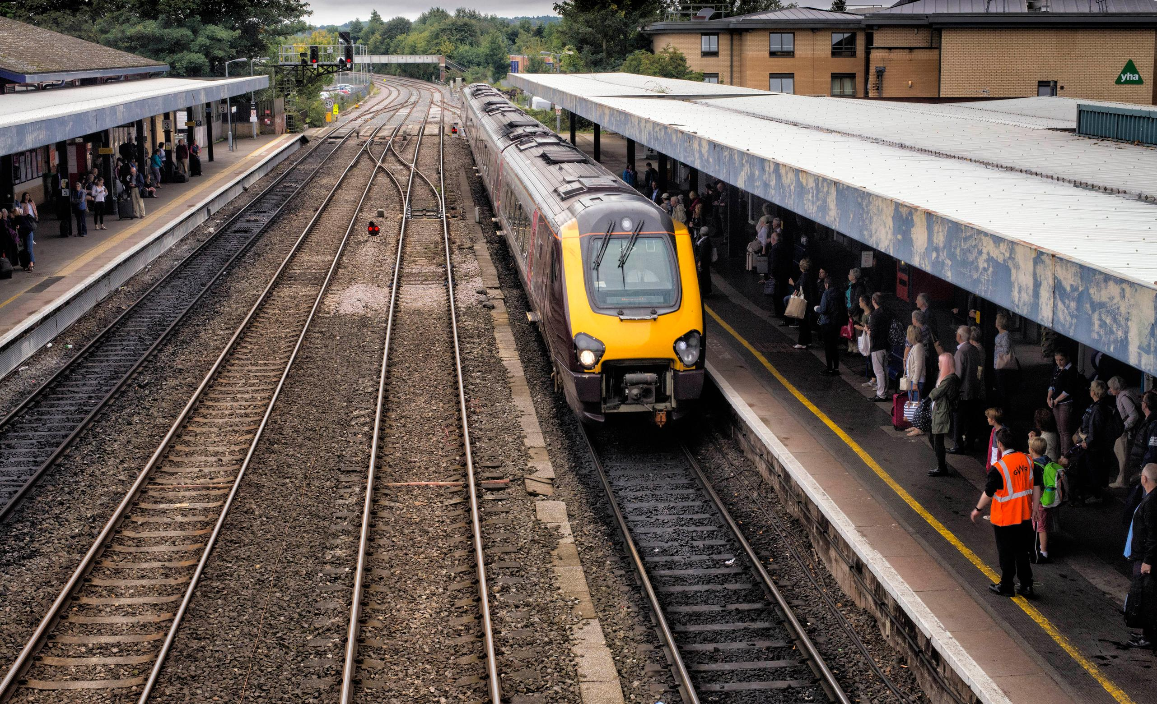
Oxford railway station
Completion of the Phase 2C works will help address a national bottleneck and enable new East-West Rail connections
Includes a significant upgrade to active travel connectivity
Discussion underway on greater quantum of cycle parking provision at the new western side
Complementary project with GWR and Network Rail to deliver significant ‘interim improvements’ over the next 18-36 months

Slide 8
East-West Rail
EWR two tph from Milton Keynes/Bletchley - hopefully from late-summer 2025
Extension to Bedford and then on to Cambridge – potentially up to six tph in the future
Discontinuous electrification and freight loops being considered
Critical importance of the scope to extend past Oxford, to serve Culham/Didcot and beyond to the west

Slide 9
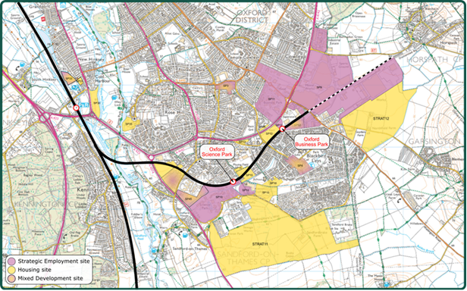
Cowley+
Two new passenger stations on this freight-only branch line that currently serves the BMW Mini plant
Nine and seven minutes to Oxford on a half-hourly frequency, with direct connections to Oxford Parkway, Bicester Village and on to London Marylebone. EWR potential
Enhanced active travel access to Science/Business Parks and new [South Oxfordshire] developments is a major opportunity

Slide 10
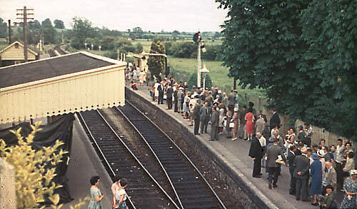
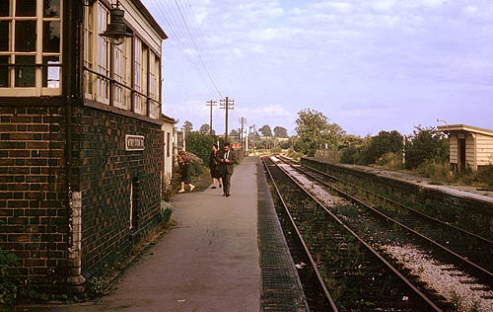
Carterton – Witney - Oxford
Outline engineering study and initial business case documents were completed last autumn. These are publicly available on our website
We are proposing an allocation in the 2024-2025 budget to continue development work and engage further with the DfT/Network Rail/GWR and Homes England
Integration with the West Oxfordshire Local Plan is essential. Land Value Capture study suggests an opportunity, but this will be locally controversial
Opportunity to include as a proposal in our updated OxRail 2040: Plan for Rail strategy

Slide 11
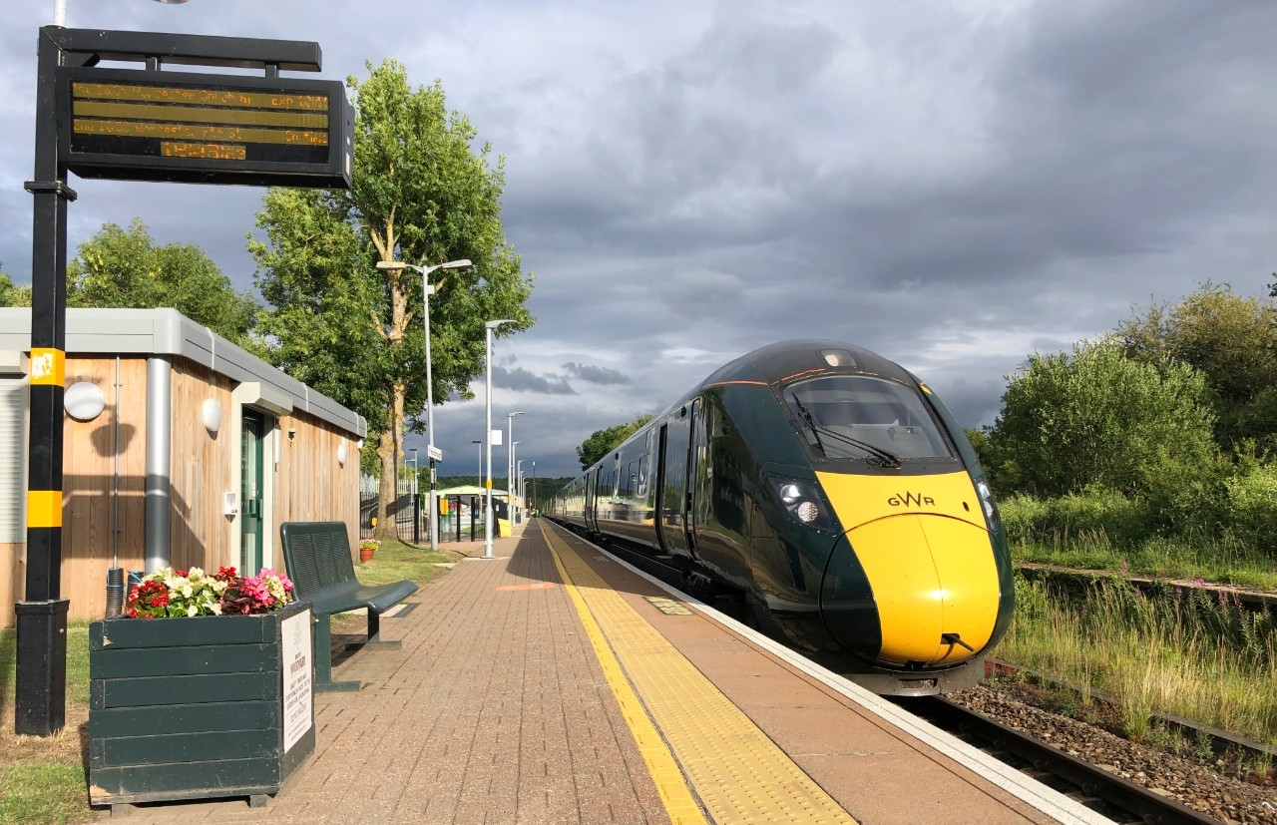
North Cotswolds Line Partnership
Line and service upgrade will support new development in Oxfordshire and further west through Worcestershire
Widespread industry and Local Authority partner support for investment – multiple benefits
Our vision is of an alternative London-Birmingham route via Oxford. Longer-term, double-tracked and electrified
The NCLP are meeting with the Rail Minister to press the case and seek support. Restarting the Hanborough Station sub-group, Local Plan link and scope to create a ‘Mobility Hub’

Slide 12
Grove for Wantage Station
Cabinet approved the commissioning of an SOBC to progress just before Christmas. Consultant to be appointed shortly and report due back in the late- summer. Discussions are underway with landowners, the District Council and Network Rail/GWR
Main challenges are the lack of a committed rail service and need for enabling rail infrastructure to support a new station
Opportunities – enabling (housing) development and consideration of station as part of the new Bristol-Oxford and extended East-West rail services

Slide 13
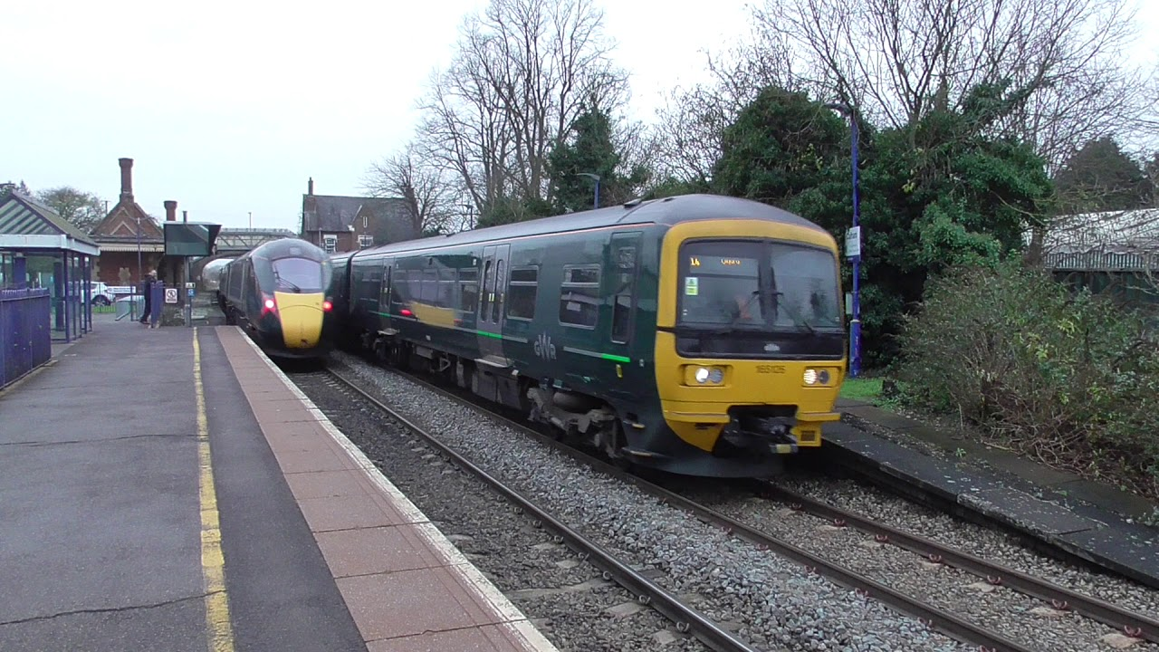
Culham Station
Strong support for a larger station at Culham to link into existing and new businesses at the ‘Science Vale’
UKAEA/CEG offering financial input for next steps – employment and housing developments support
Modest service enhancements commenced from the December 2023 timetable change. GWR commissioning station designs

Slide 14
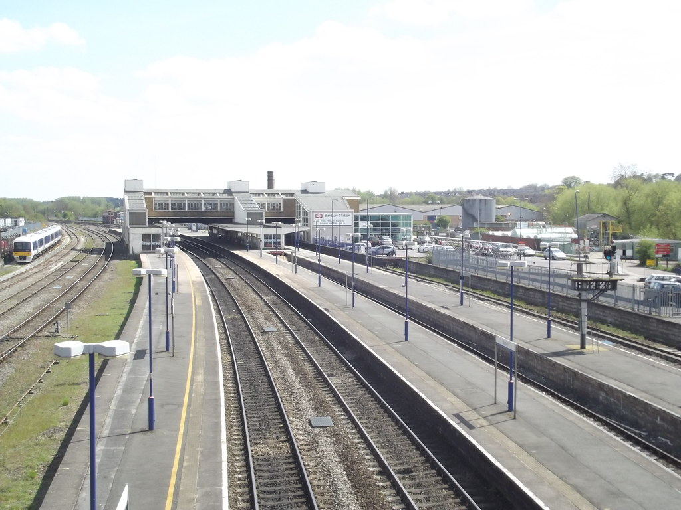
Banbury railway station
A high priority for Chiltern Railways, Oxfordshire County and Cherwell District Council’s
A key gateway to support delivering Cherwell District Council’s Banbury 2050 Vision
New café, steam deep-clean and repainting
Tramway Road project to provide new bus access and potential to create a ‘Mobility Hub’. Cherwell Street bus lane
We are working with partners to scope out a major upgrade to the main station entrance/forecourt, focussing on improved pedestrian links to the town centre and potentially a large, secure cycle store

Slide 15
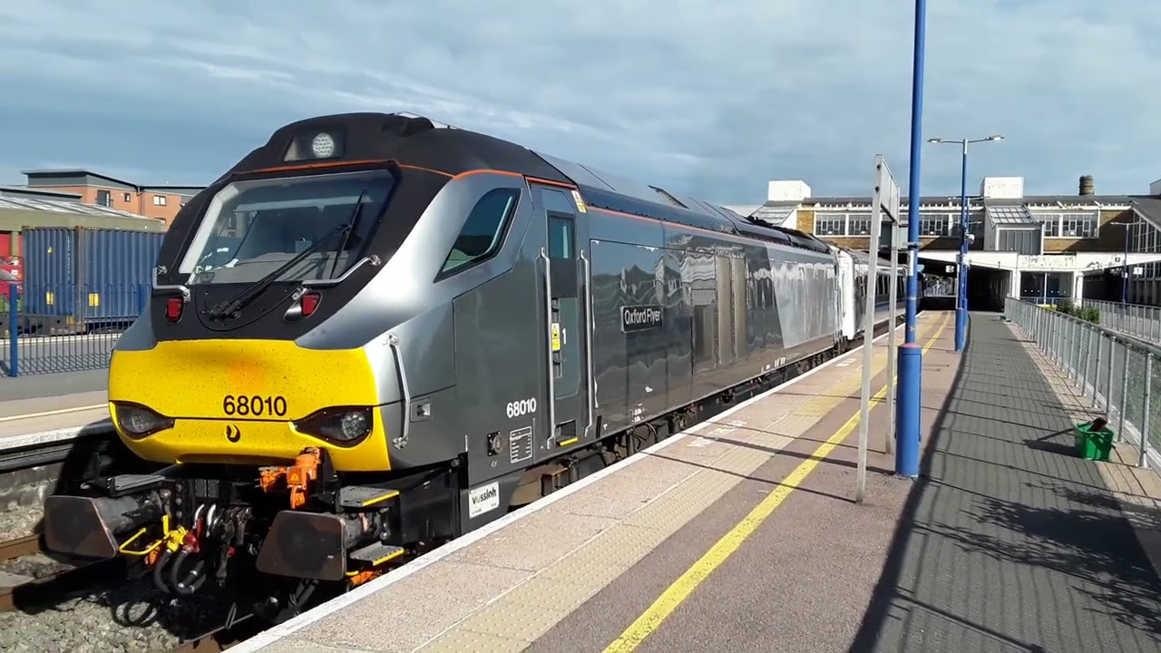
Rolling stock and services
Chiltern Railways ‘Right Route 2030’ vision for new hybrid multiple units and cascaded Mk5 coaching rakes
Cross-Country additional and heavily refurbished Voyagers
GWR ‘Project Churchward’ for a substantial new fleet of hybrid units
Didcot-Oxford wiring would enable greater use of the new electric/hybrid units
Scope for enhanced frequencies at Banbury, Didcot and Culham to improve links to Oxford

Slide 16
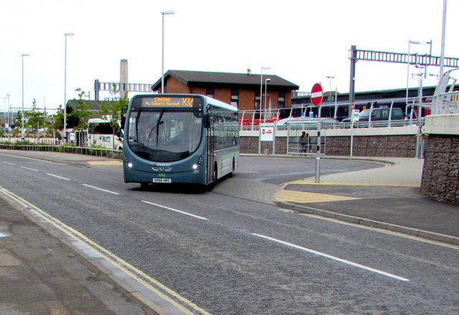
Integration is key
Every railway station in the County will eventually become a mobility hub - some good examples already exist (Didcot)
Focus initially on developing Oxford, Banbury, Culham, and Oxford Parkway (OUFC link). Hanborough station links to Blenheim Palace, Charlbury and residential development across West Oxfordshire
Discussing linking bus services and joint-ticketing with Go-Ahead and Stagecoach
Developing the ‘Oxford Metro’ concept

Slide 17
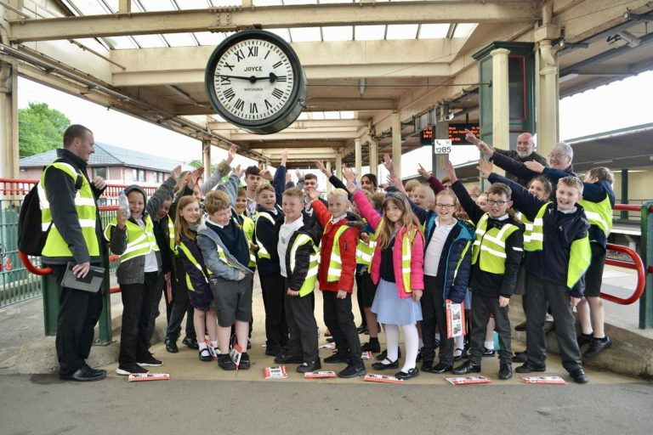
Oxfordshire Community Rail Partnership
Giving our communities a voice and bringing the rail industry along
Projects in delivery at Didcot, Banbury and Bicester North
Next year planned to focus on Oxford and Hanborough railway stations, with further work at Banbury and Didcot
Small, rural stations offer great scope for local involvement – discussions underway on Charlbury

Slide 18
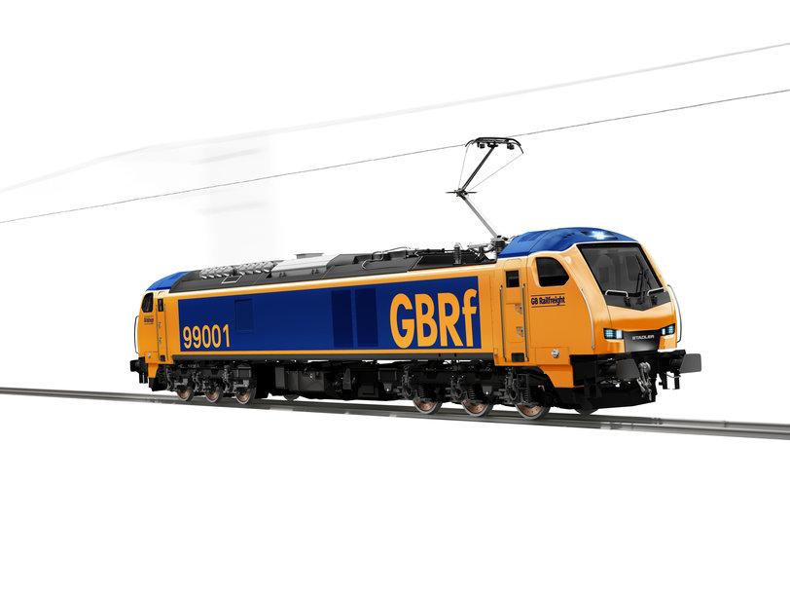
A sustainable future
An electric railway is a better railway
Need to have a strong focus on freight – intermodal, aggregates and high-value parcels to remove HGVs and vans from Oxfordshire’s roads
The Nuneham Viaduct collapse highlighted the need to make structures and earthworks more resilient
We are committing meaningful resources to deliver a step-change transformation in collaboration with the rail industry

Slide 19
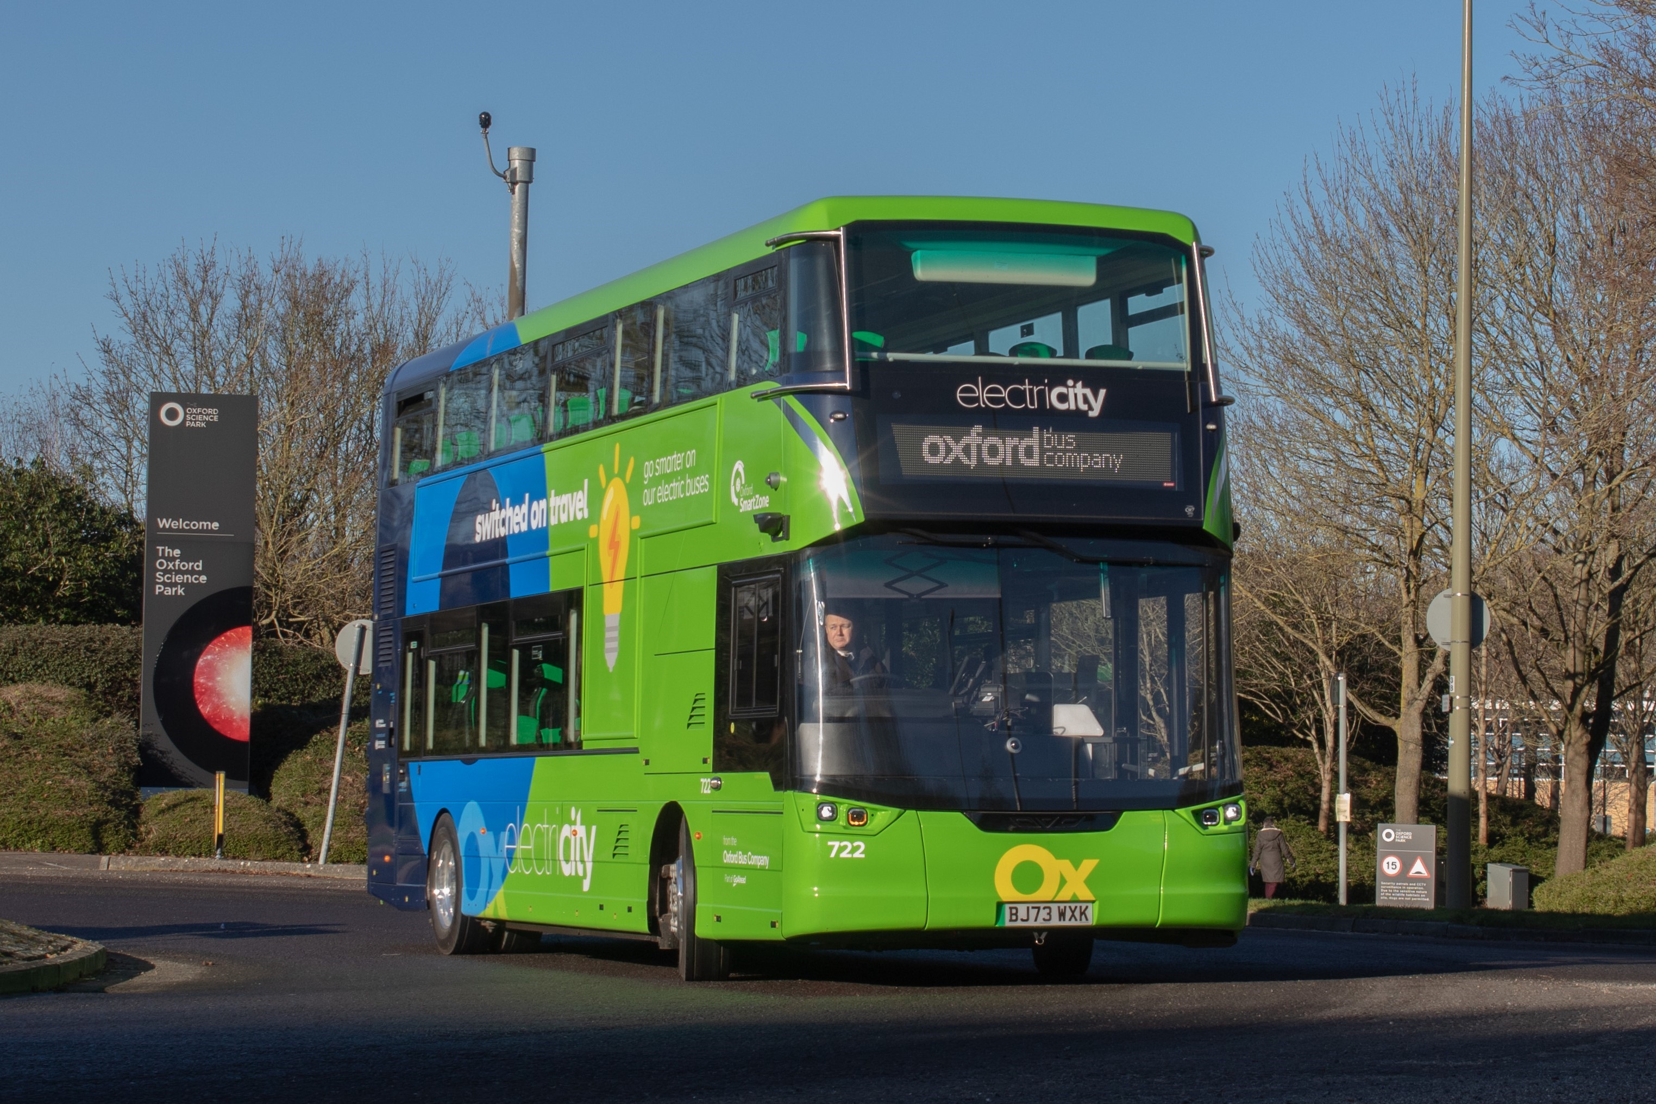
Working together
With District Council colleagues, the Universities and Hospitals, major employers and our local communities
More joint-delivery with bus operators, taxi firms and a stronger focus on Active Travel links and improved infrastructure
Lobbying/promoting/influencing. We are very keen on the proposed devolved South-East rail body. Oxfordshire Rail summit pencilled-in for late-September/early-October

Slide 20
Thank-you
Any questions?

