Slide 1
Oxfordshire County Council
Parish Transport Representatives' meeting
Case study: 230 service in South Bedfordshire

Slide 2
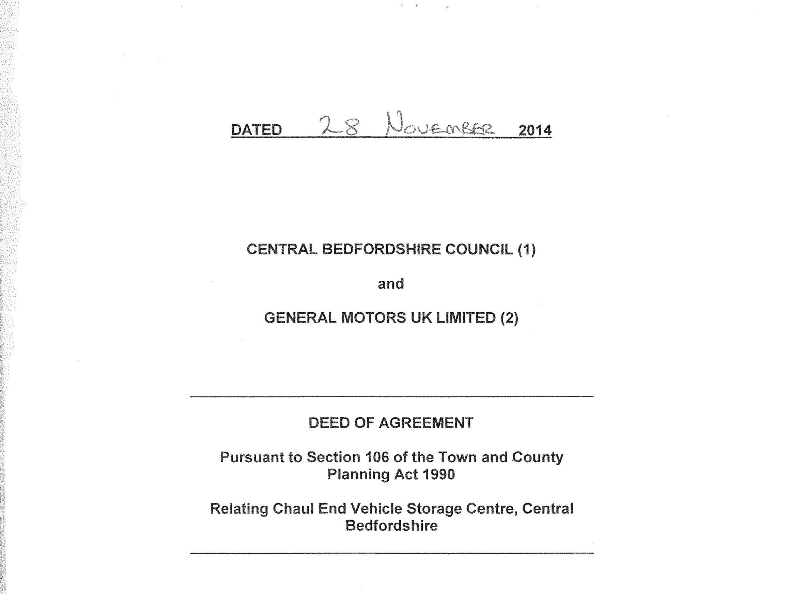
Notes:
History of the Chaul End site leading to its development for housing. Slightly remote from village centre.

Slide 3

Notes:
CaSE formed from S106 agreement. KMC former Chair and now Trust Manager

Slide 4
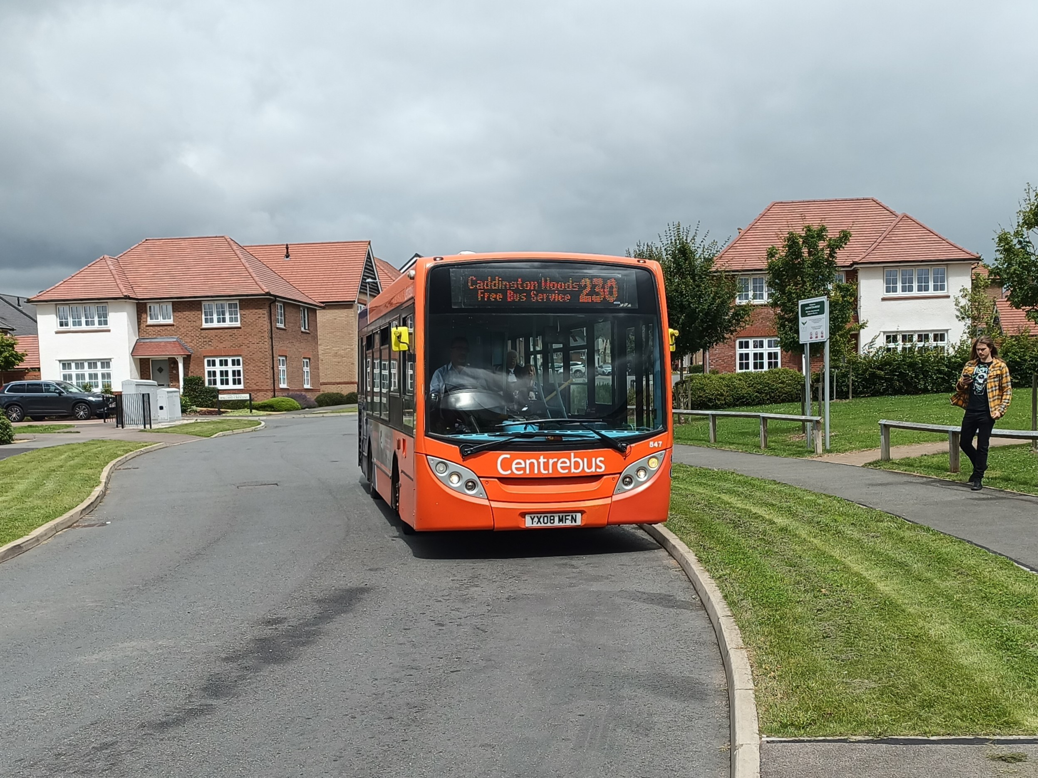
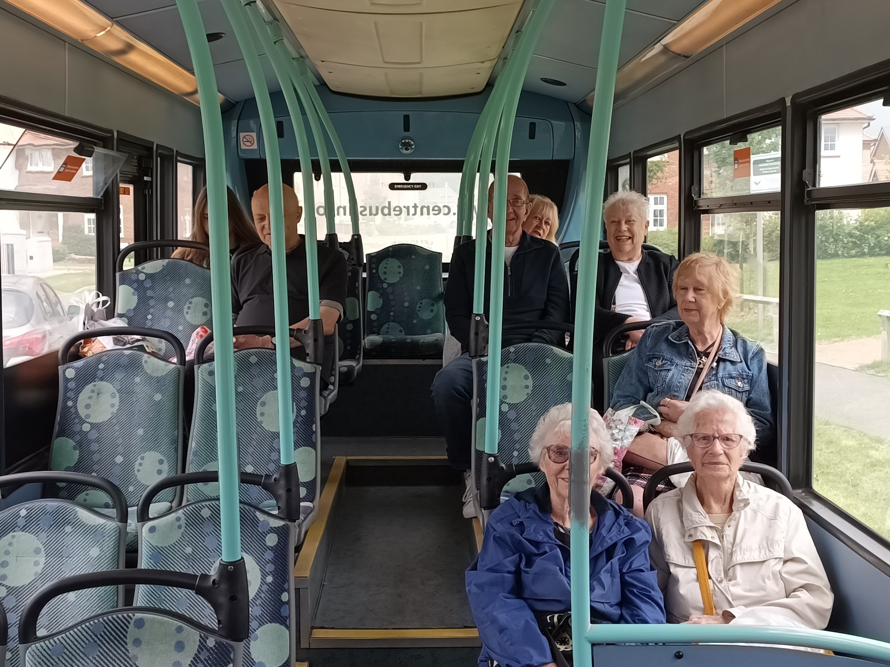
Notes:
Taken mid-day today!

Slide 5
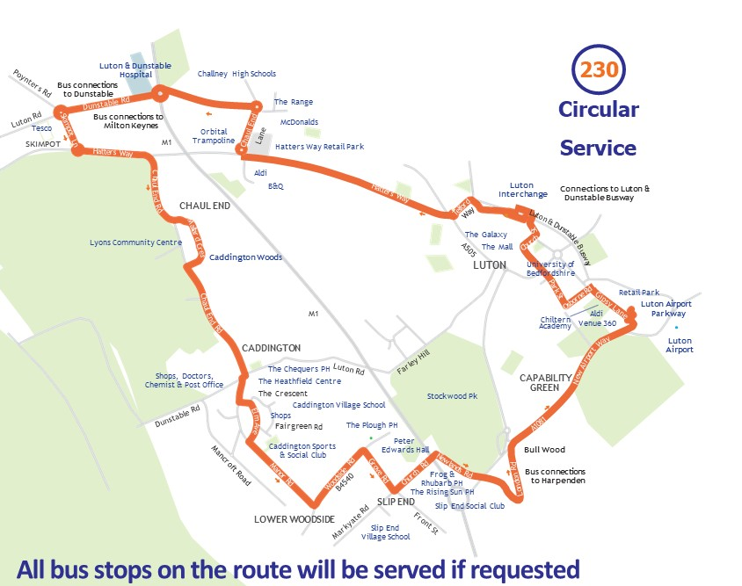
Notes:
The route. Full circle, one way. Surprisingly it works!

Slide 6
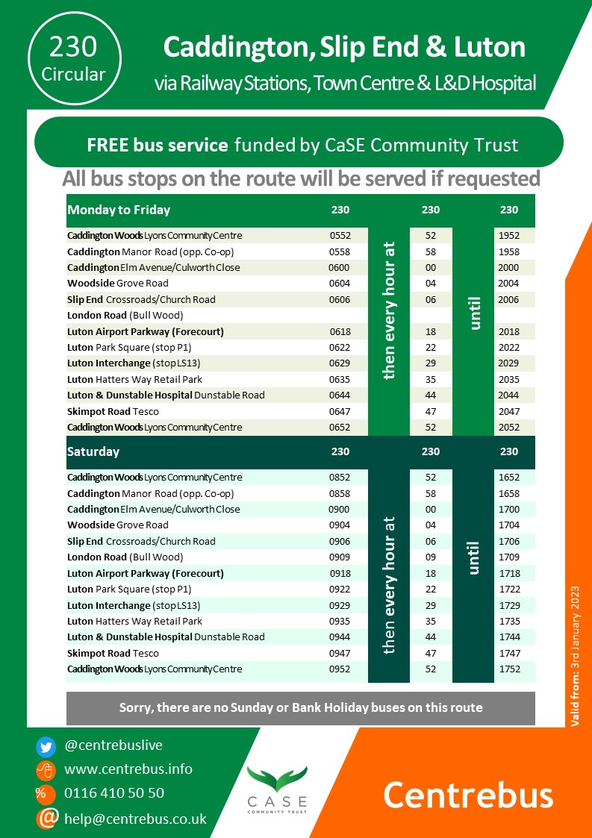
Notes:
The timetable. Every hour.

Slide 7
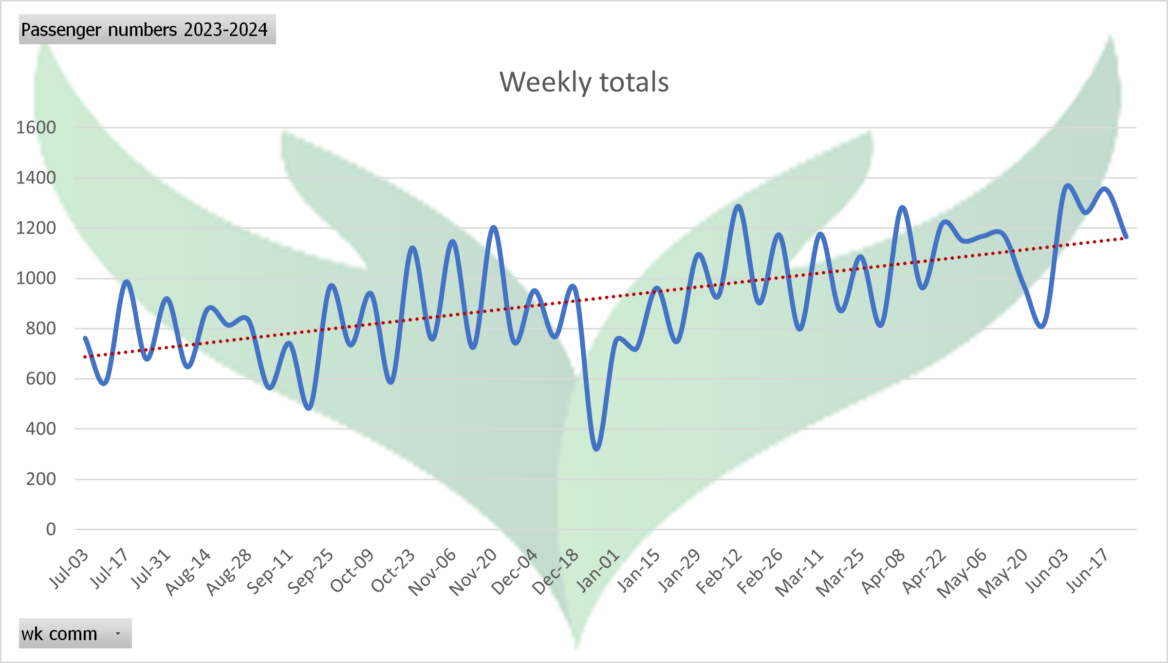
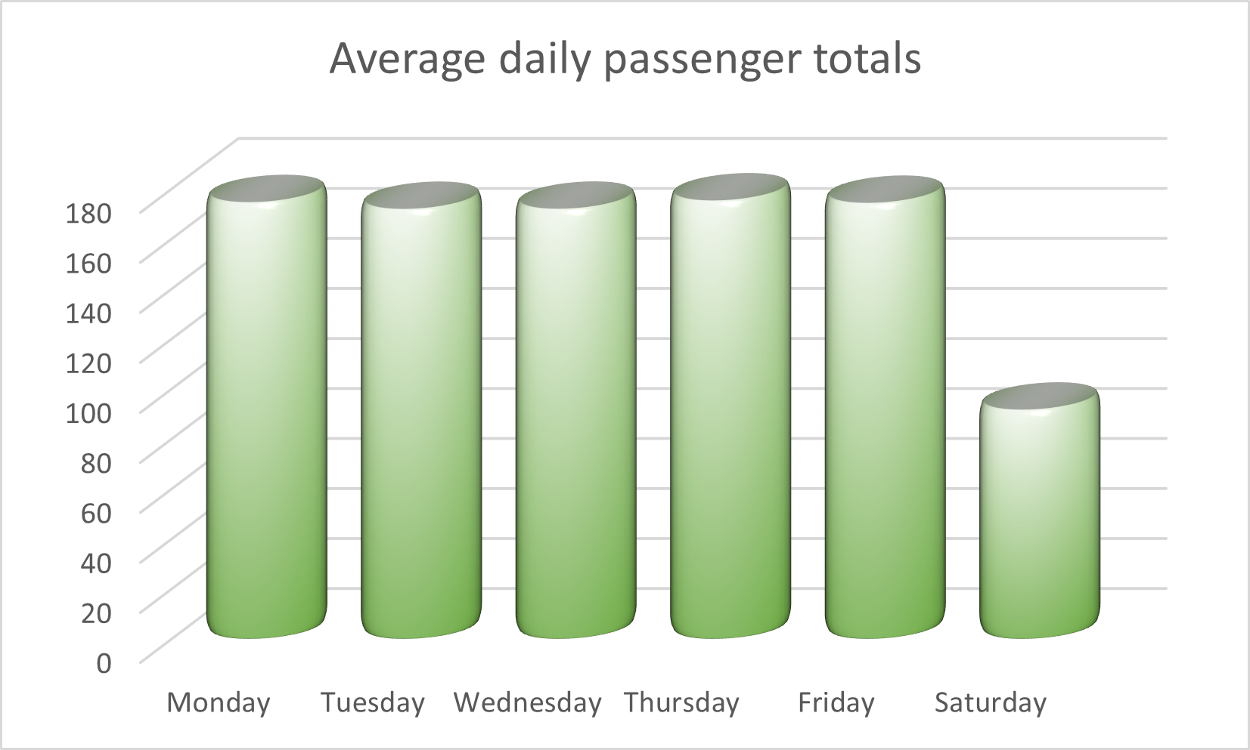
Notes:
Reporting back

