Slide 1

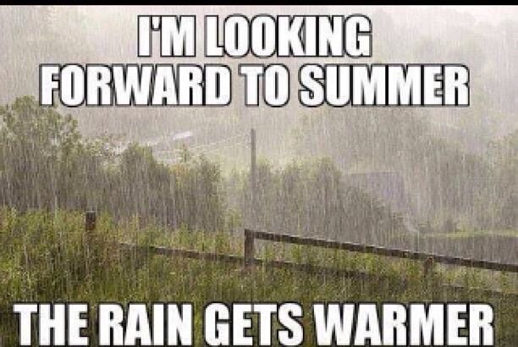
Public Transport
Team update
Dave Harrison, Public Transport Team Leader
Parish Transport Representatives – 16 July 2024

Slide 2

What’s been going on
BSIP refresh:
  Oxfordshire Bus Service Improvement Plan
  Describes current offer and existing improvement programme
  Sets out ambitions for 2025-30:
    Service improvement
    Bus priority
    Fares and ticketing
    Passenger experience
    Bus fleet enhancement
    Network transformation
Bus Connectivity Assessment
Electric bus roll-out
Launch of new services

Slide 3

What’s been going on
Latest bus tender process to conclude this week 🥇:
  New service between Redbridge, Oxford Science Park, Cowley and JR Hospital (600)
  Improved service between Witney, Oxford North and Headington (H2)
  Continuation of Didcot – Harwell – Newbury/ Wantage services (X34/X35)
  X9, X40 and 3A improvements
  Continuation of 14, 25, 29/H5, 200 and 275

Slide 4

What’s been going on
New countywide fares scheme launched on Sunday:
  Over 150 routes run by 12 operators
  Day and weekly tickets
  Adult and young person versions
  BSIP-funded until March 2025
  www.mybusoxfordshire.org.uk

Slide 5

Future plans
New government – clarity on direction awaited
CMD on 10 October 2024:
  seeking a decision on new contracts, including continuation of BSIP-funded services
  March 2025 start, largest tender round for some years

Slide 6

Future plans
Bus maps
  New printed and digital county bus map
  Town maps
  Where to catch your bus maps
  Diagrammatic maps (hospitals, tourist, MyBus validity etc)
Franchising study
Demand Responsive Transport study

Slide 7

Questions?
Dave Harrison
Public Transport Team Leader
dave.harrison@oxfordshire.gov.uk
07901 331751

