Slide 1

PRESENTATION TO THE PTR MEETING NOV 24
OURBUS BARTONS Richard Brown MBE
rbrown.ourbusbartons@gmail.com
www.ourbusbartons.org.uk

Slide 2

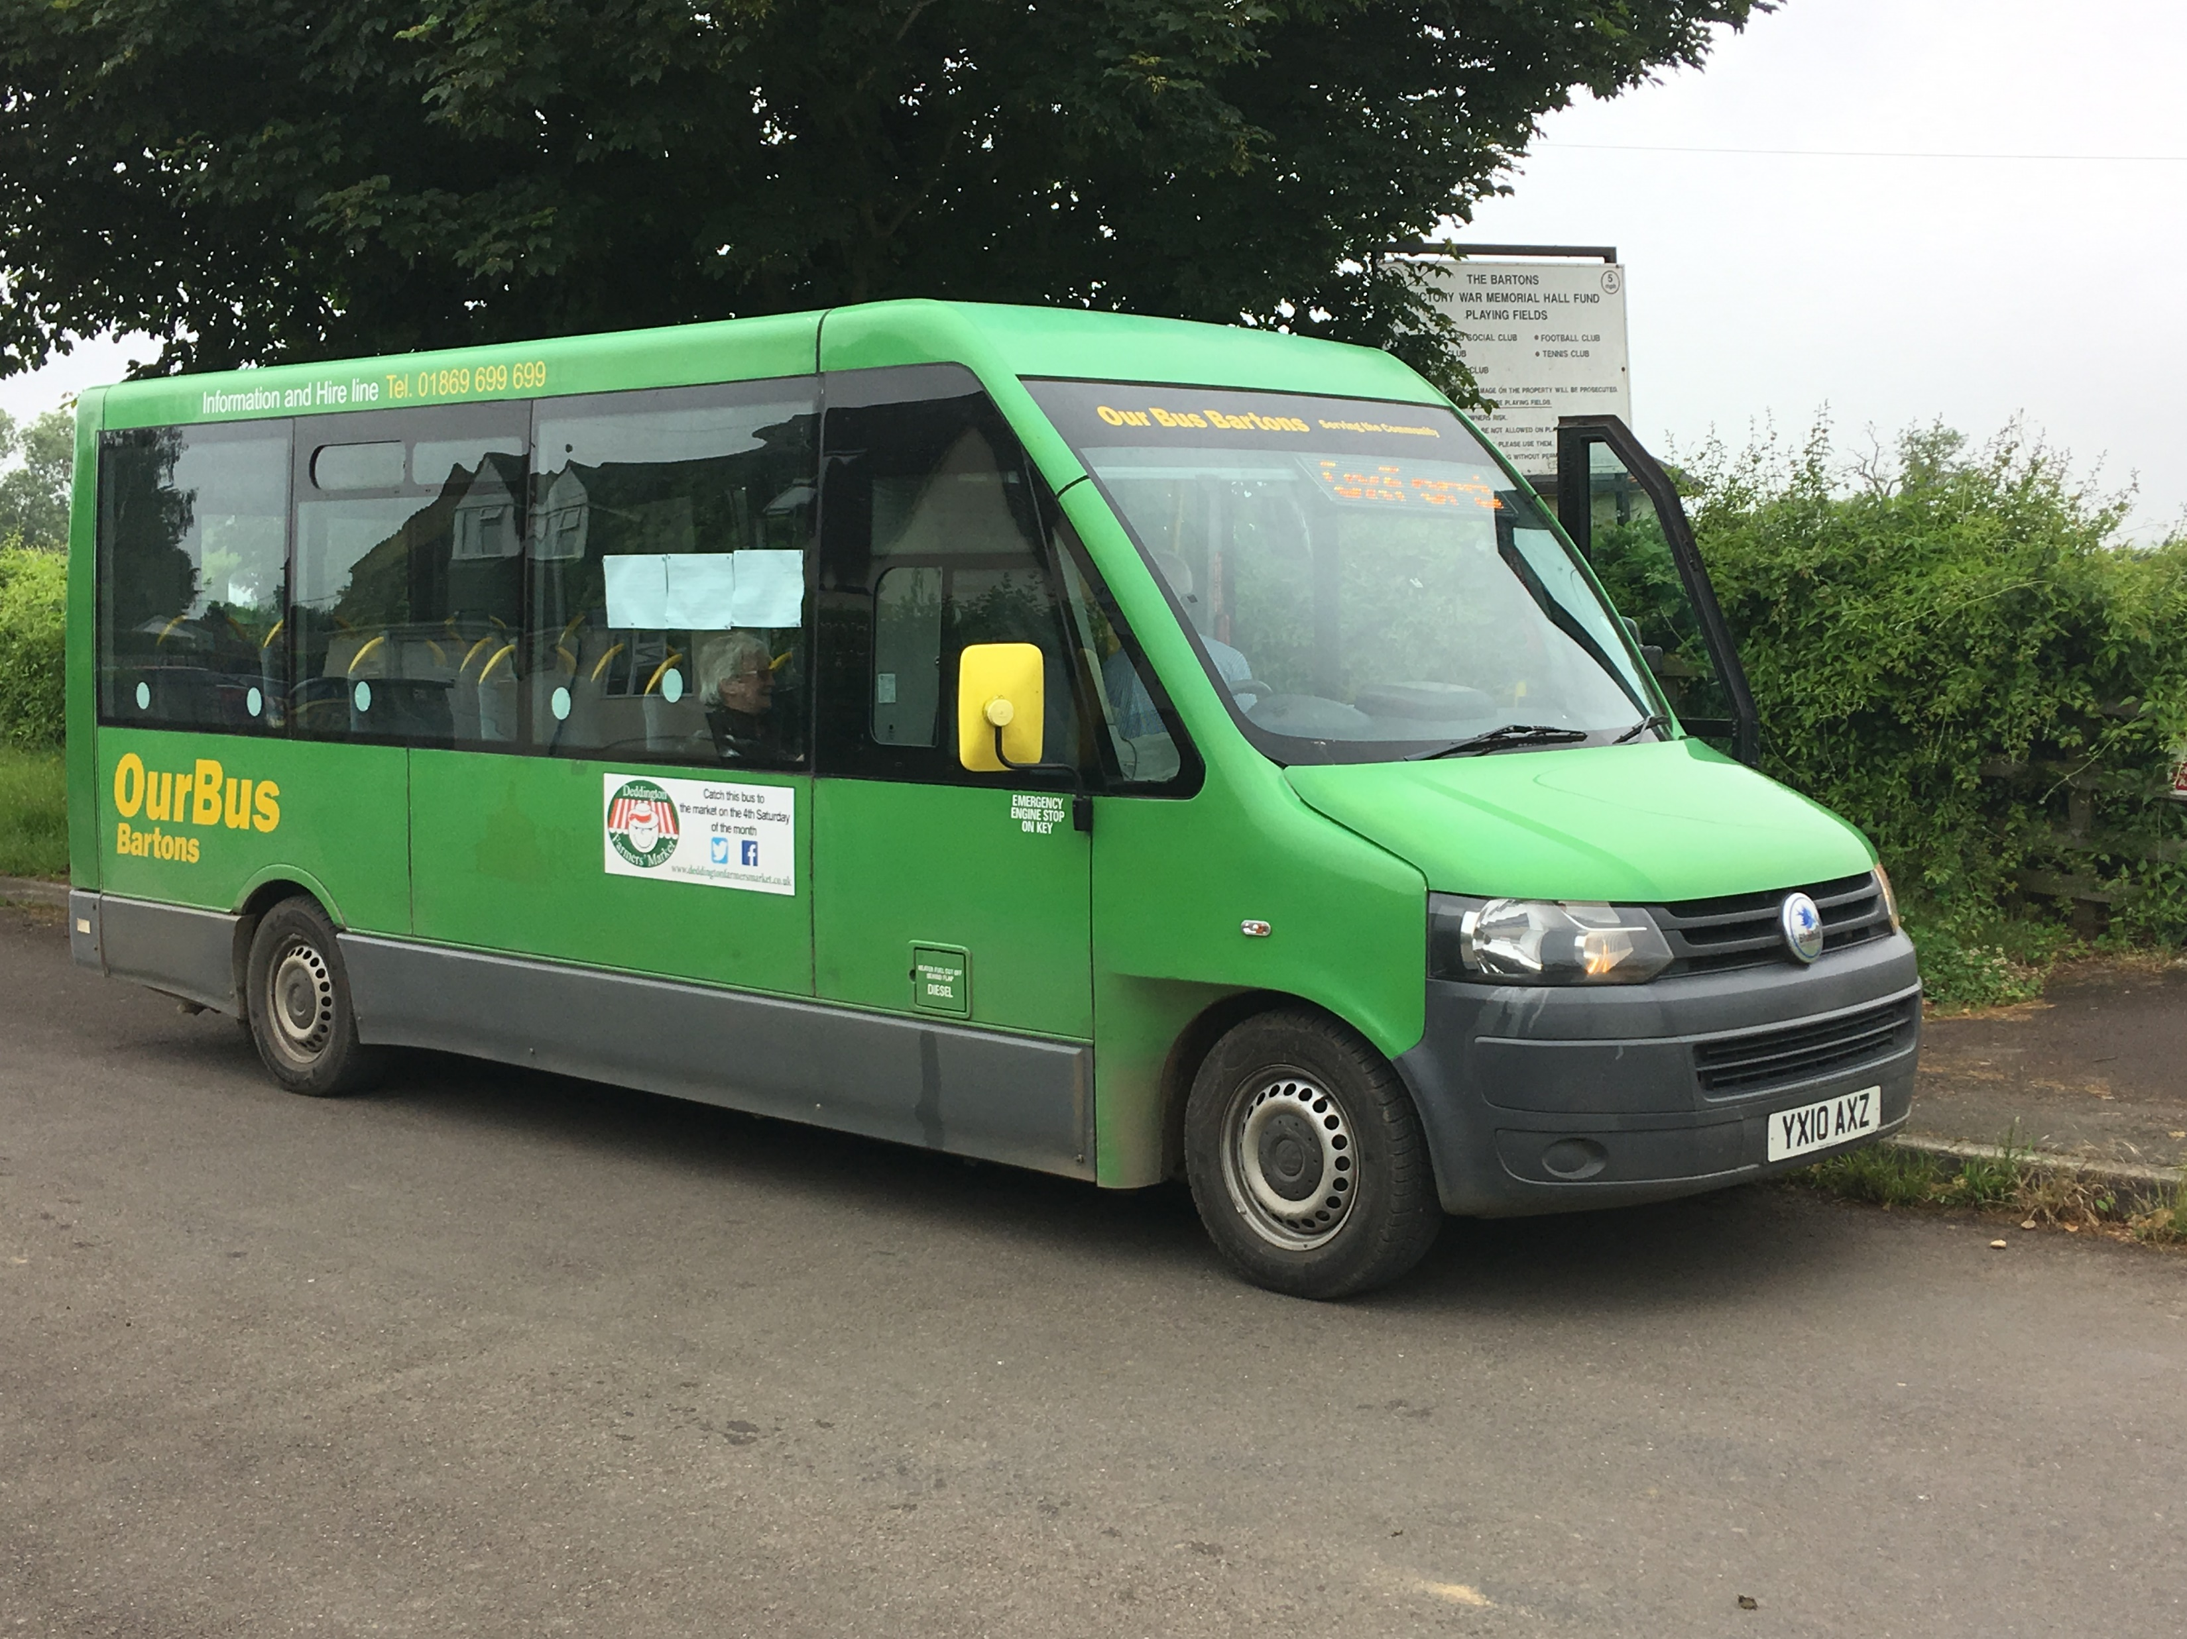
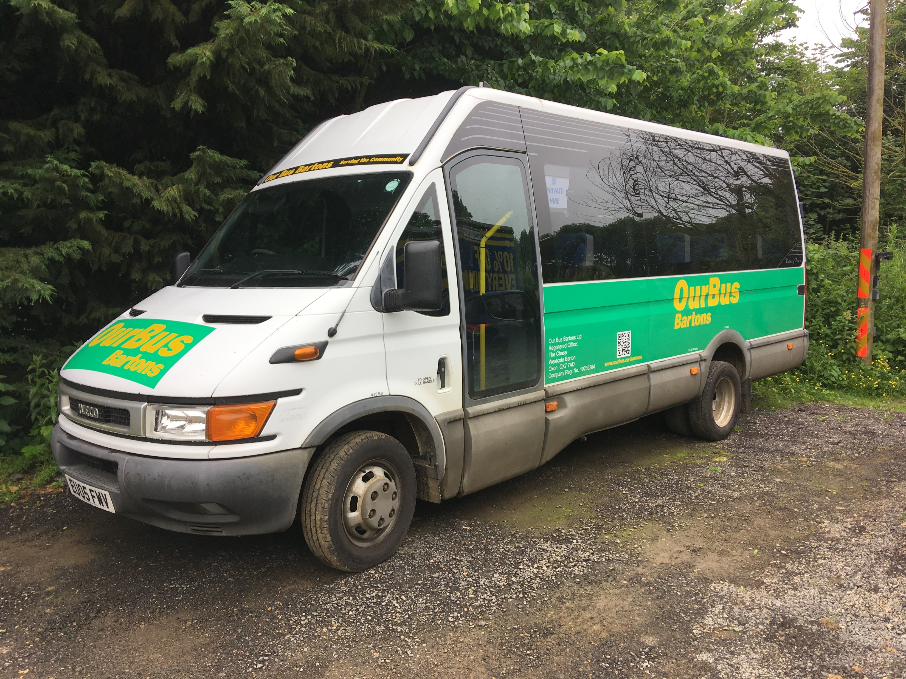
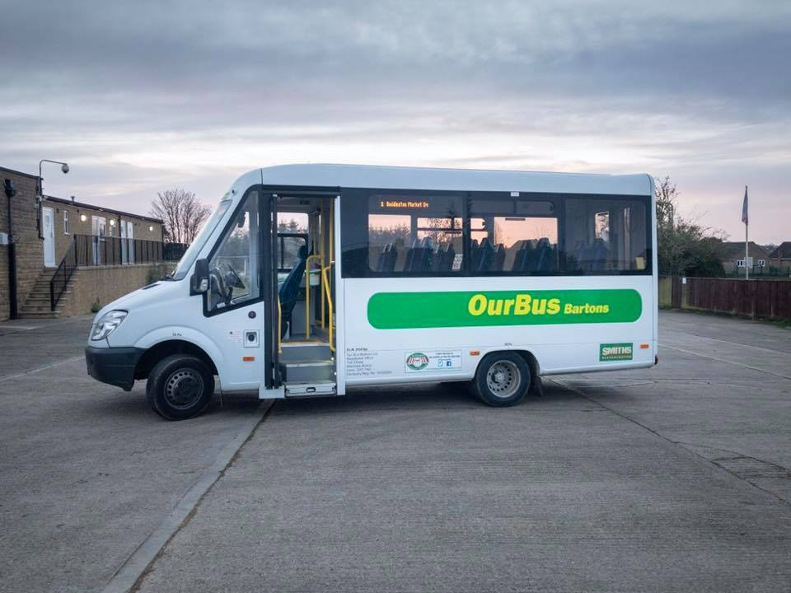
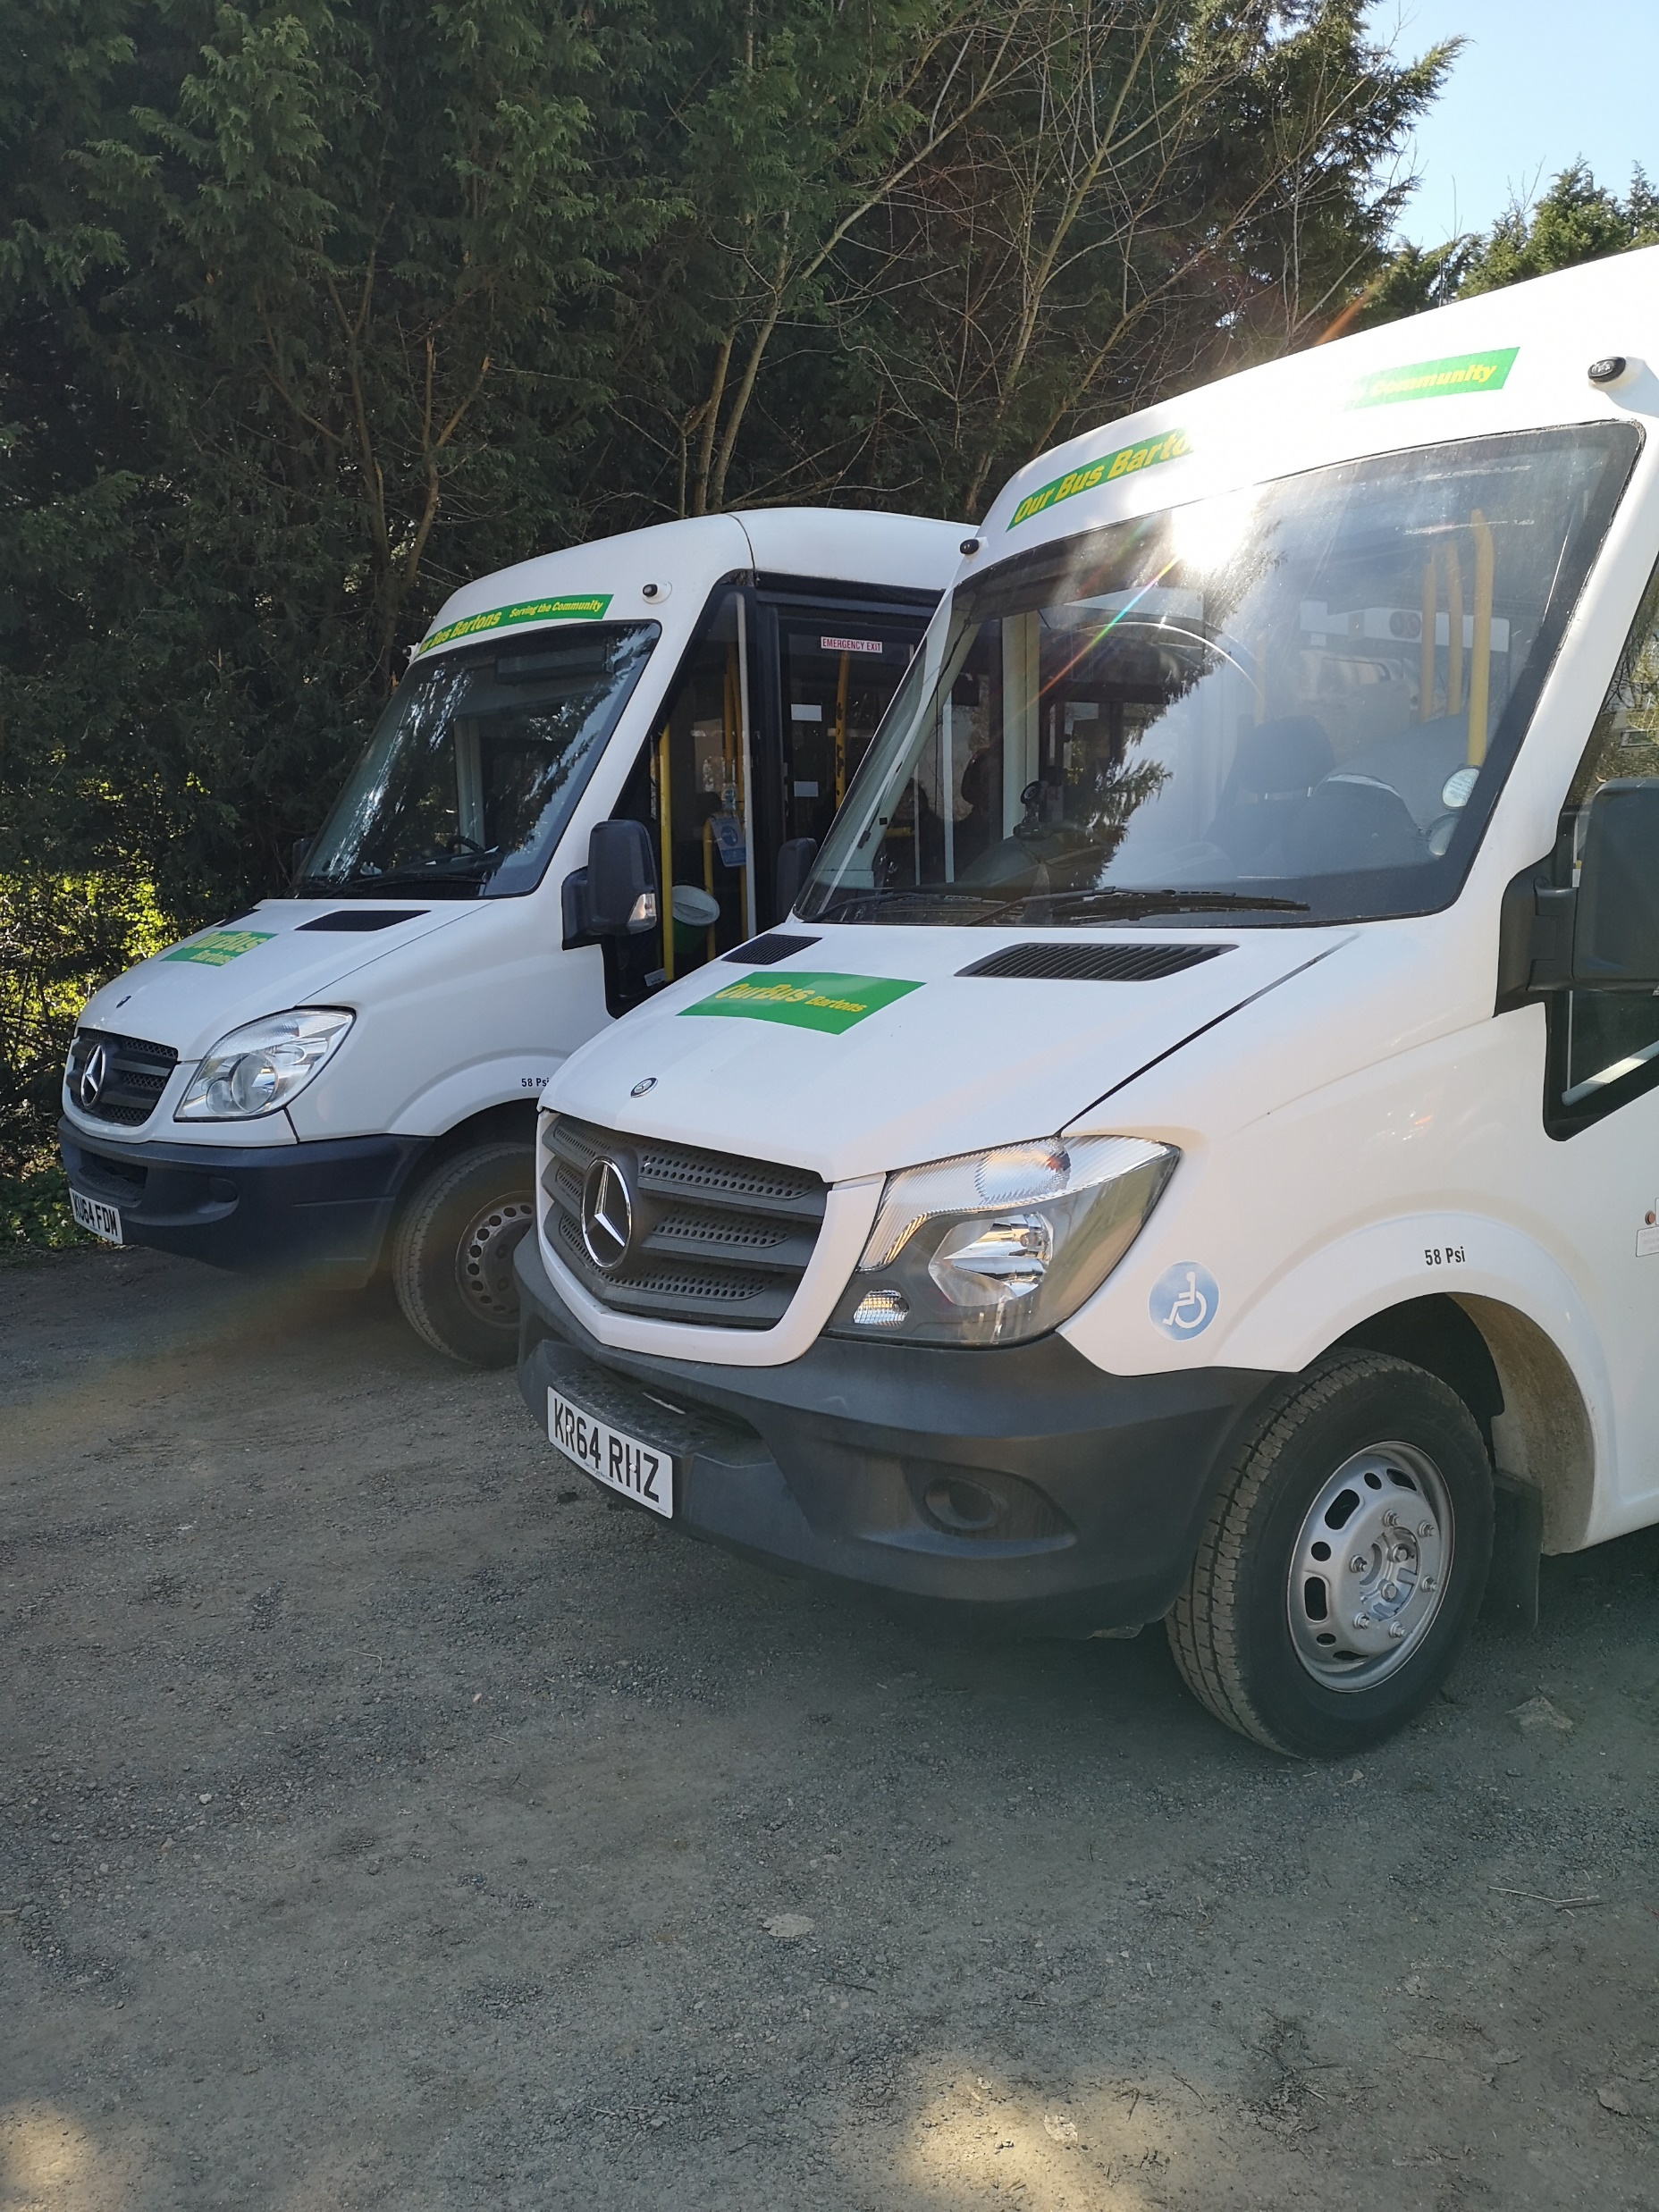
PRESENTATION TO THE PTR MEETING NOV 24
Our Buses, fleet evolution
Current
BELINDA
1ST BELINDA…
BLANCHE
BELLA
BELLA &
BROWN MBE
FOLLOWED BY BELLA
THEN BLANCHE

Slide 3
PRESENTATION TO THE PTR MEETING NOV 24

Slide 4
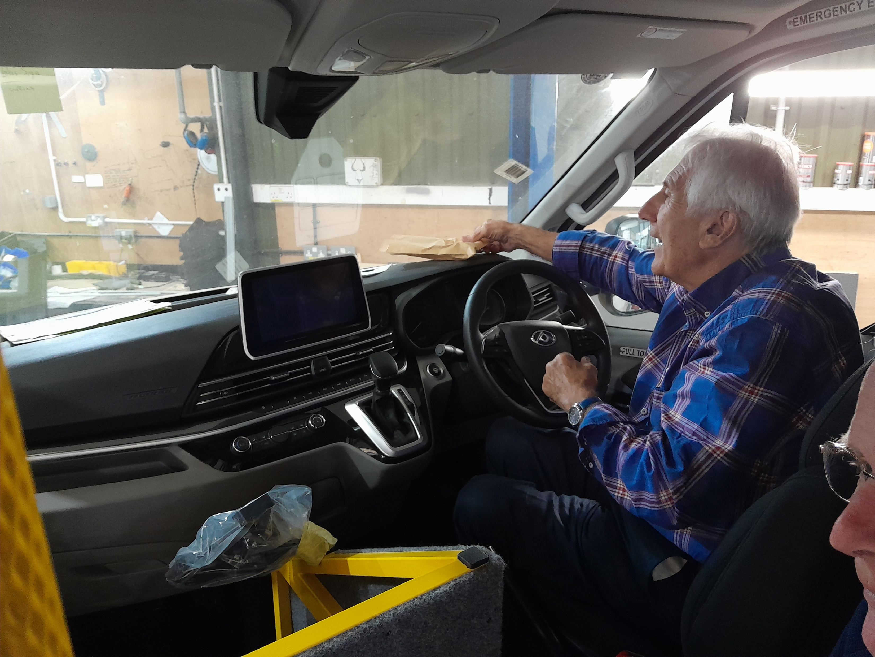
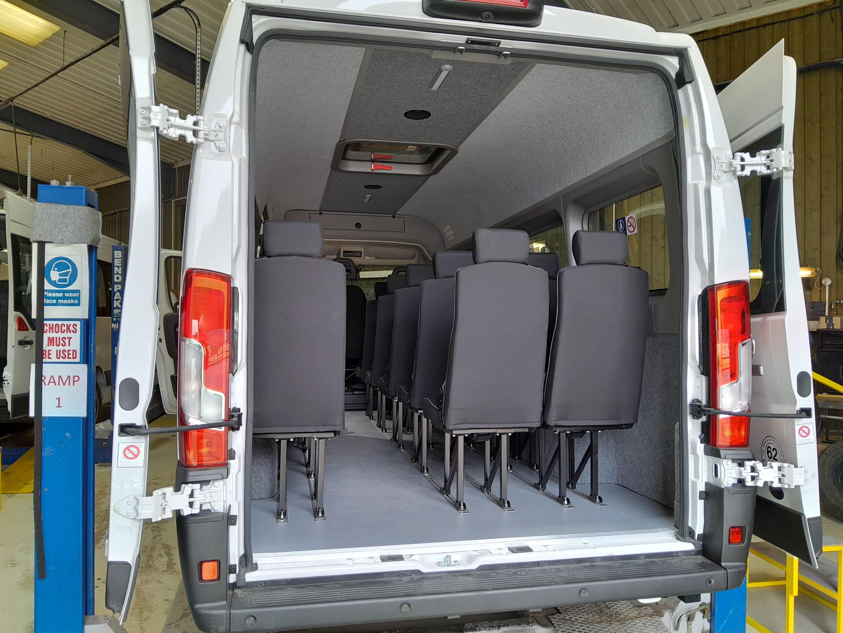
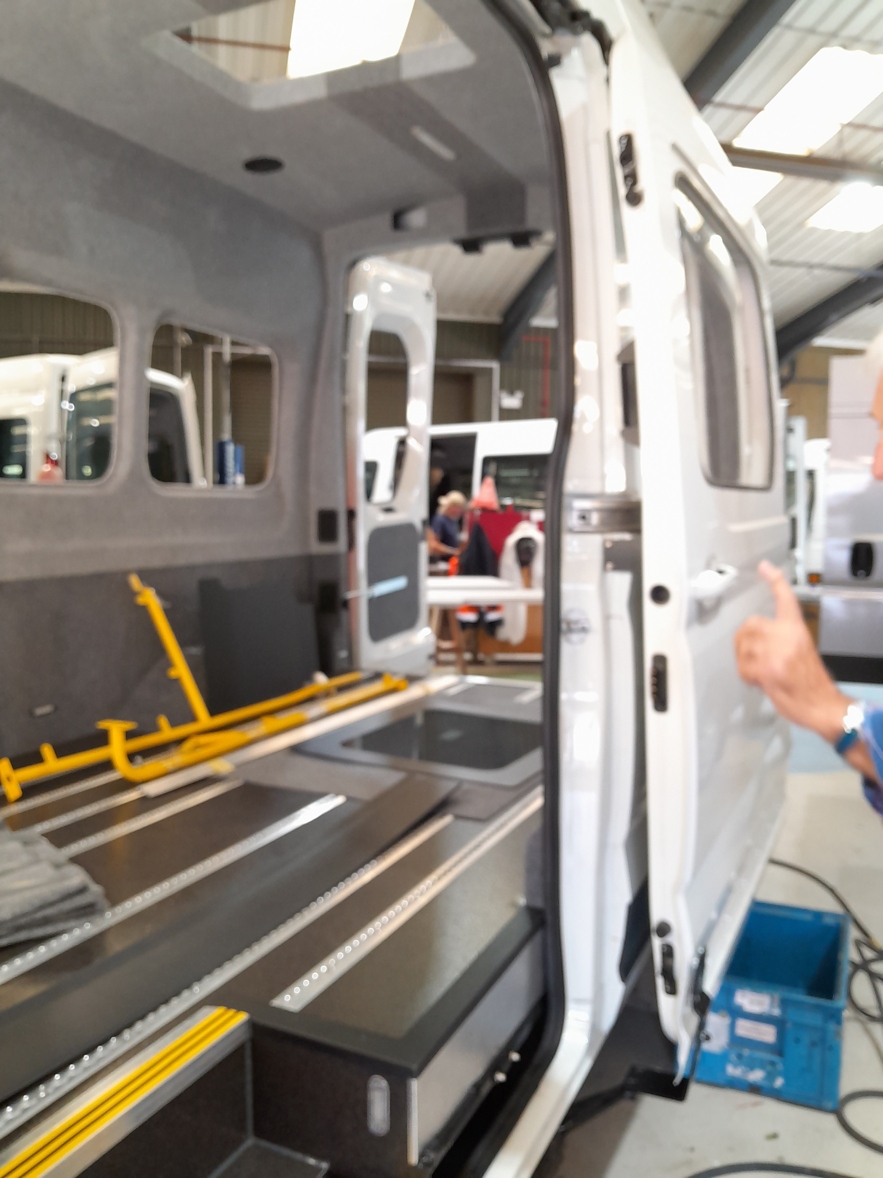
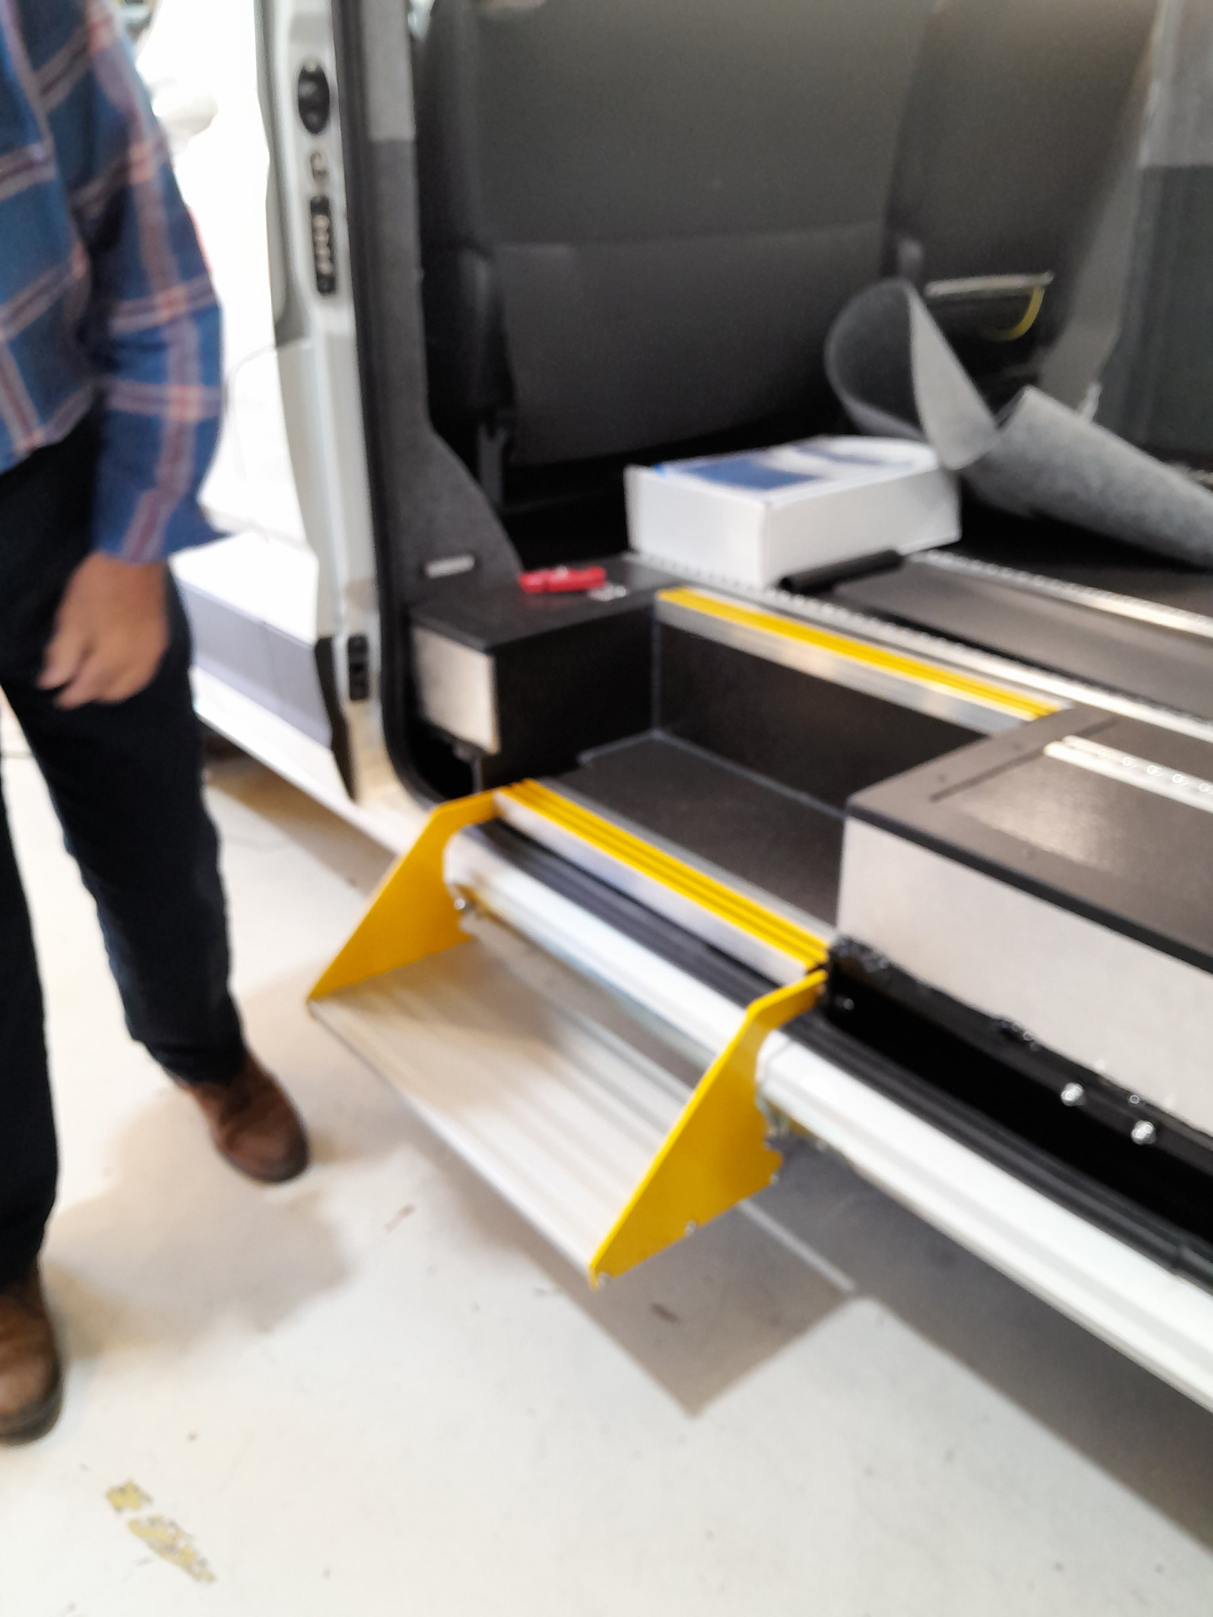
PRESENTATION TO THE PTR MEETING NOV 24
New buses, build progress, our recent visit to GM Coachworks in Newton Abbott
Currently, modifications to passenger door, step access, shopping storage area, plus locations of Ticket and Card payment equipment to ensure safety and operational convenience.

Slide 5
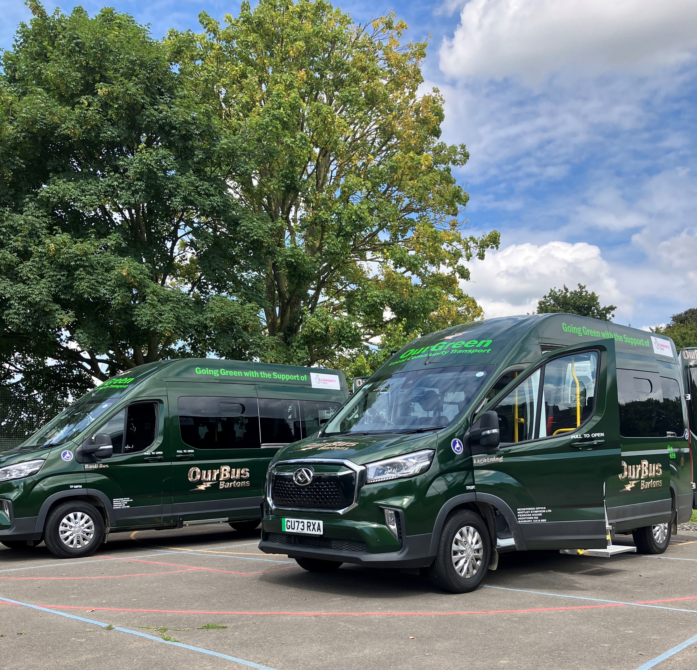
PRESENTATION TO THE PTR MEETING NOV 24
July 2024 - Introducing: Lightning & Basil Bus!

