Slide 1

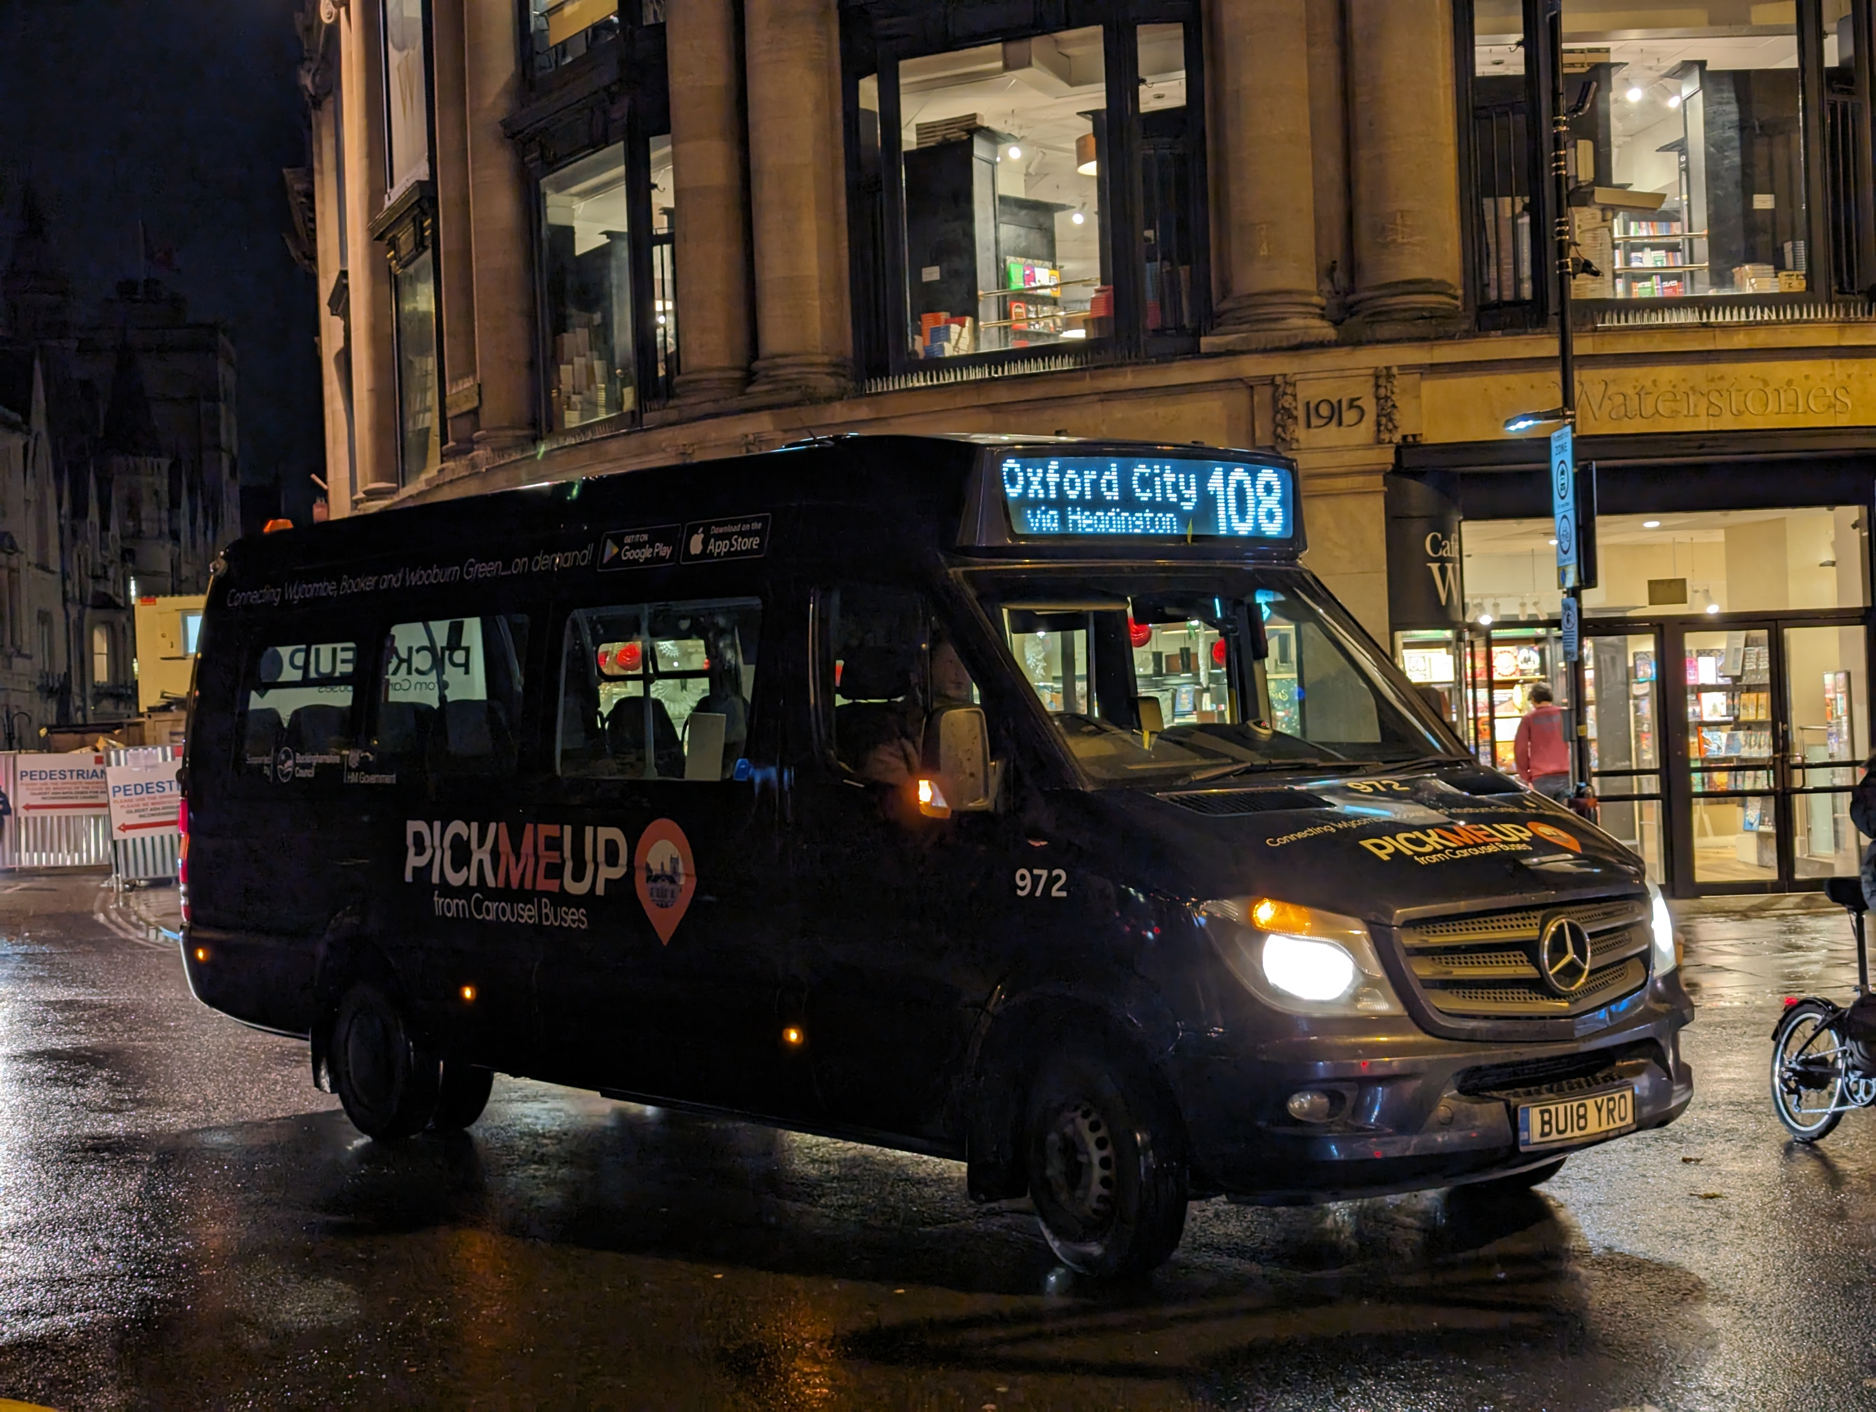
Public Transport
Team update
Ed Webster, Public Transport Planner
Parish Transport Representatives – 8 July 2025

Slide 2
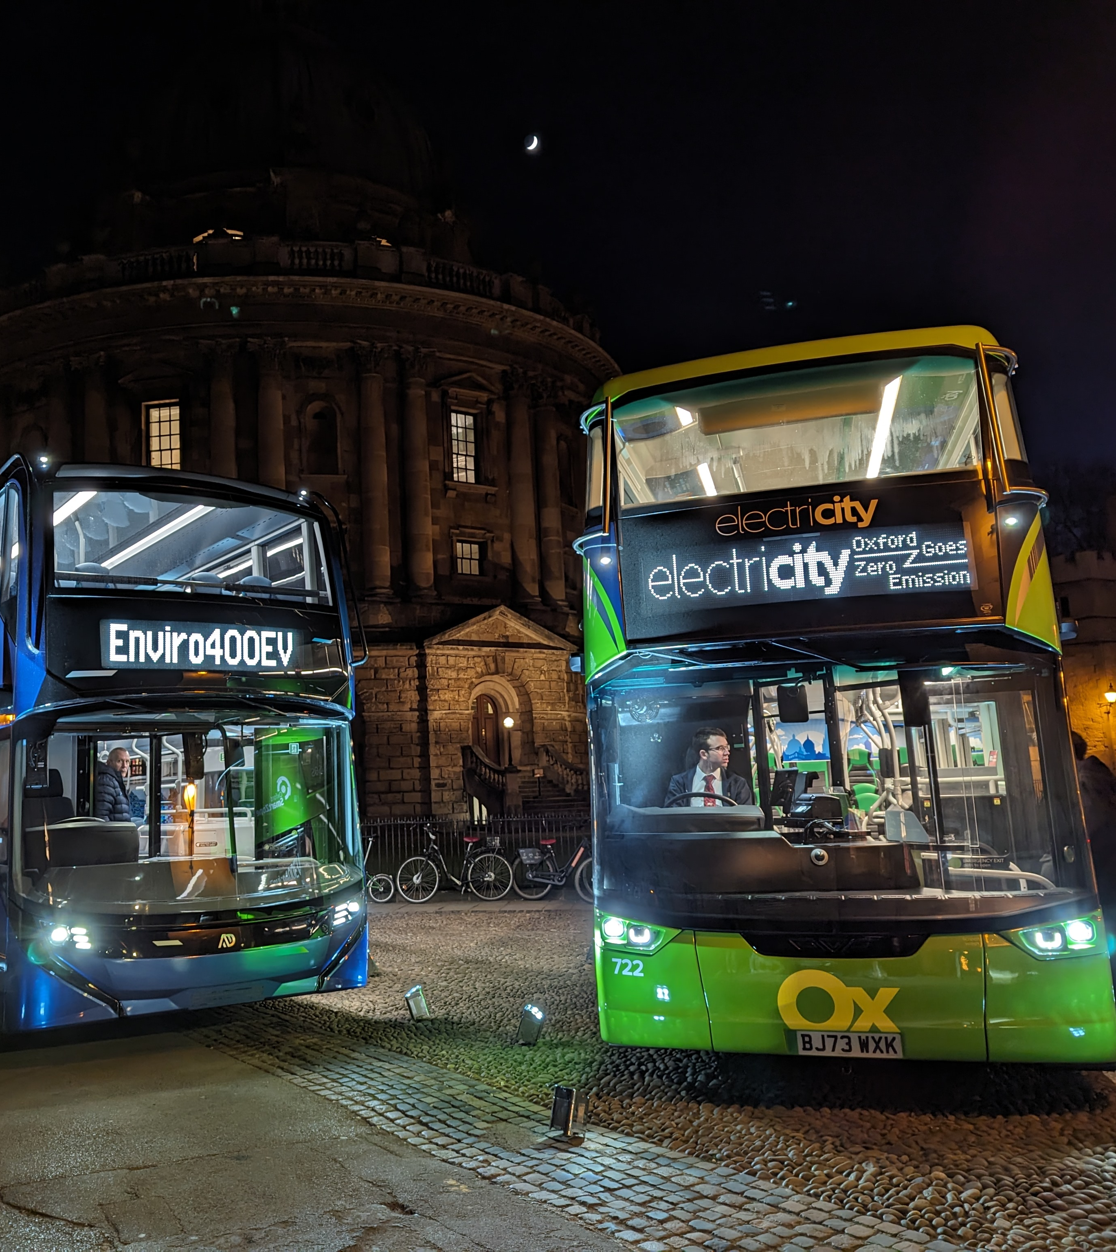
What’s been going on
BSIP Delivery Plan 2025/26:
  Approved by Cabinet Member on 27 March
  Submitted to Government on 31 March
Services funded:
  15 existing BSIP services
  9 services transferred from other budgets
  8 new improvements to existing services
  1 service protected from commercial withdrawal

Slide 3
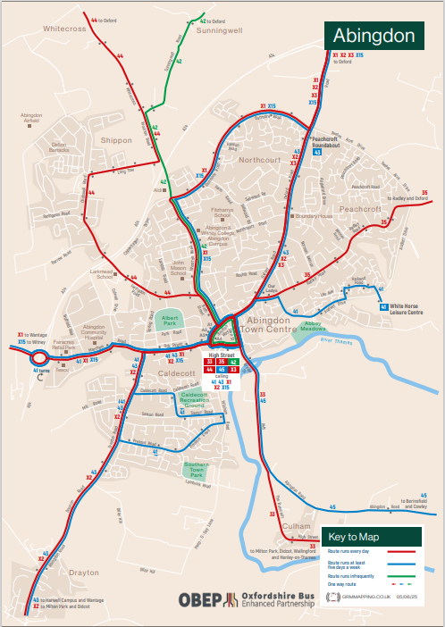
What’s been going on
New bus maps
  Town and county online maps launching very soon
  Interactive map and timetables will be available
  Hospitals Tube-style map
Studies update
  Future bus models study complete and due to be considered in October
  DRT study: stage 1 (review) complete

Slide 4

What’s been going on
MyBus review
  Ticket has been hugely popular, particularly since change to fare cap
  200,000 sold since July 2024
  Cost is a concern and fare increase being considered
  www.mybusoxfordshire.org.uk

Slide 5
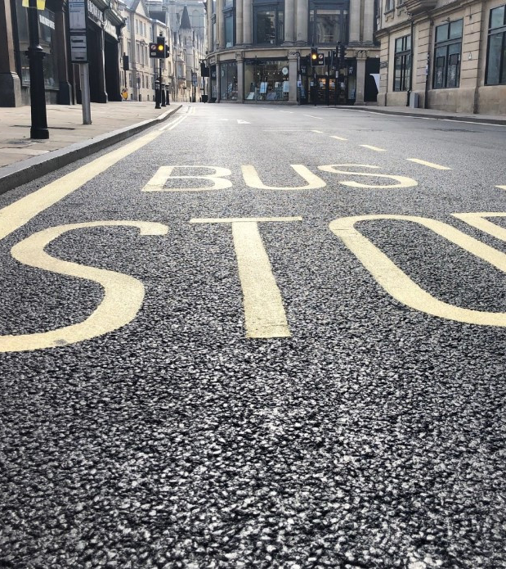
Future plans
BSIP Infrastructure:
  More real time information screens
  Traffic light priority schemes
  Gloucester Green bus station improvement
  £575k bus stop improvement programme
Vehicle Improvement Fund:
  £1.4m for zero emission buses, ticketing enhancements etc.
Scheme development:
  Benson Lane, Crowmarsh
  John Radcliffe Hospital bus priority
  Horspath Driftway queue relocation

Slide 6
Upcoming service changes
July and August 2025:
  25/29 (Bicester): new Sunday service (to be confirmed)
  108: Revised route in Stanton St John
  134 (Goring): to be operated by Thames Travel to revised route/timetable
  136 (Cholsey): improved to half hourly
  139 (Benson): replaced by diversion of service 33
  275 (Chinnor): to be operated by Red Rose Travel
  800 (Oxford): new half hourly service between Horspath Road Ind Est, Redbridge Park & Ride and City Centre
  801 (Chipping Norton): new hourly Sunday service
  B3/B4 (Banbury): new hourly Sunday service
  H5 (Bicester): two additional PM journeys
  S9 (Wantage): temporary reduction in off-peak frequency to every 30 mins
  X4 (Banbury): improvement to four journeys (currently two)
  X32 (Didcot): improvement to every 20 mins on weekdays

Slide 7
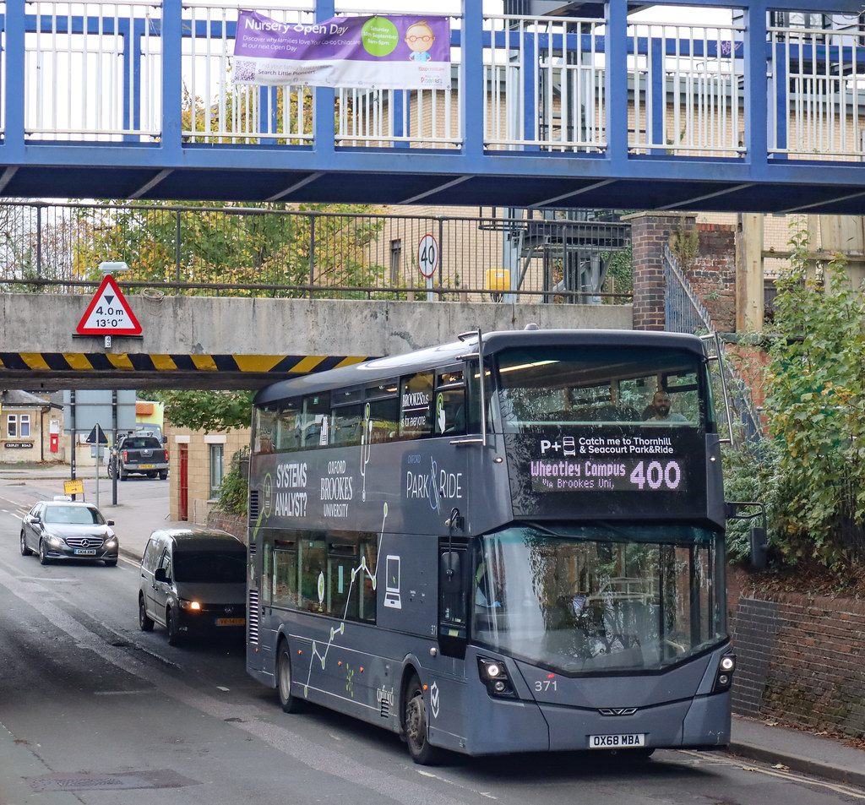
Botley Road closure
Closure extended by Network Rail until August 2026
Service changes in August 2025:
  400 withdrawn west of Oxford station
  New service 4B to/from Harcourt Hill (every 30 mins Mon-Sat daytime)
  Through tickets retained

Slide 8
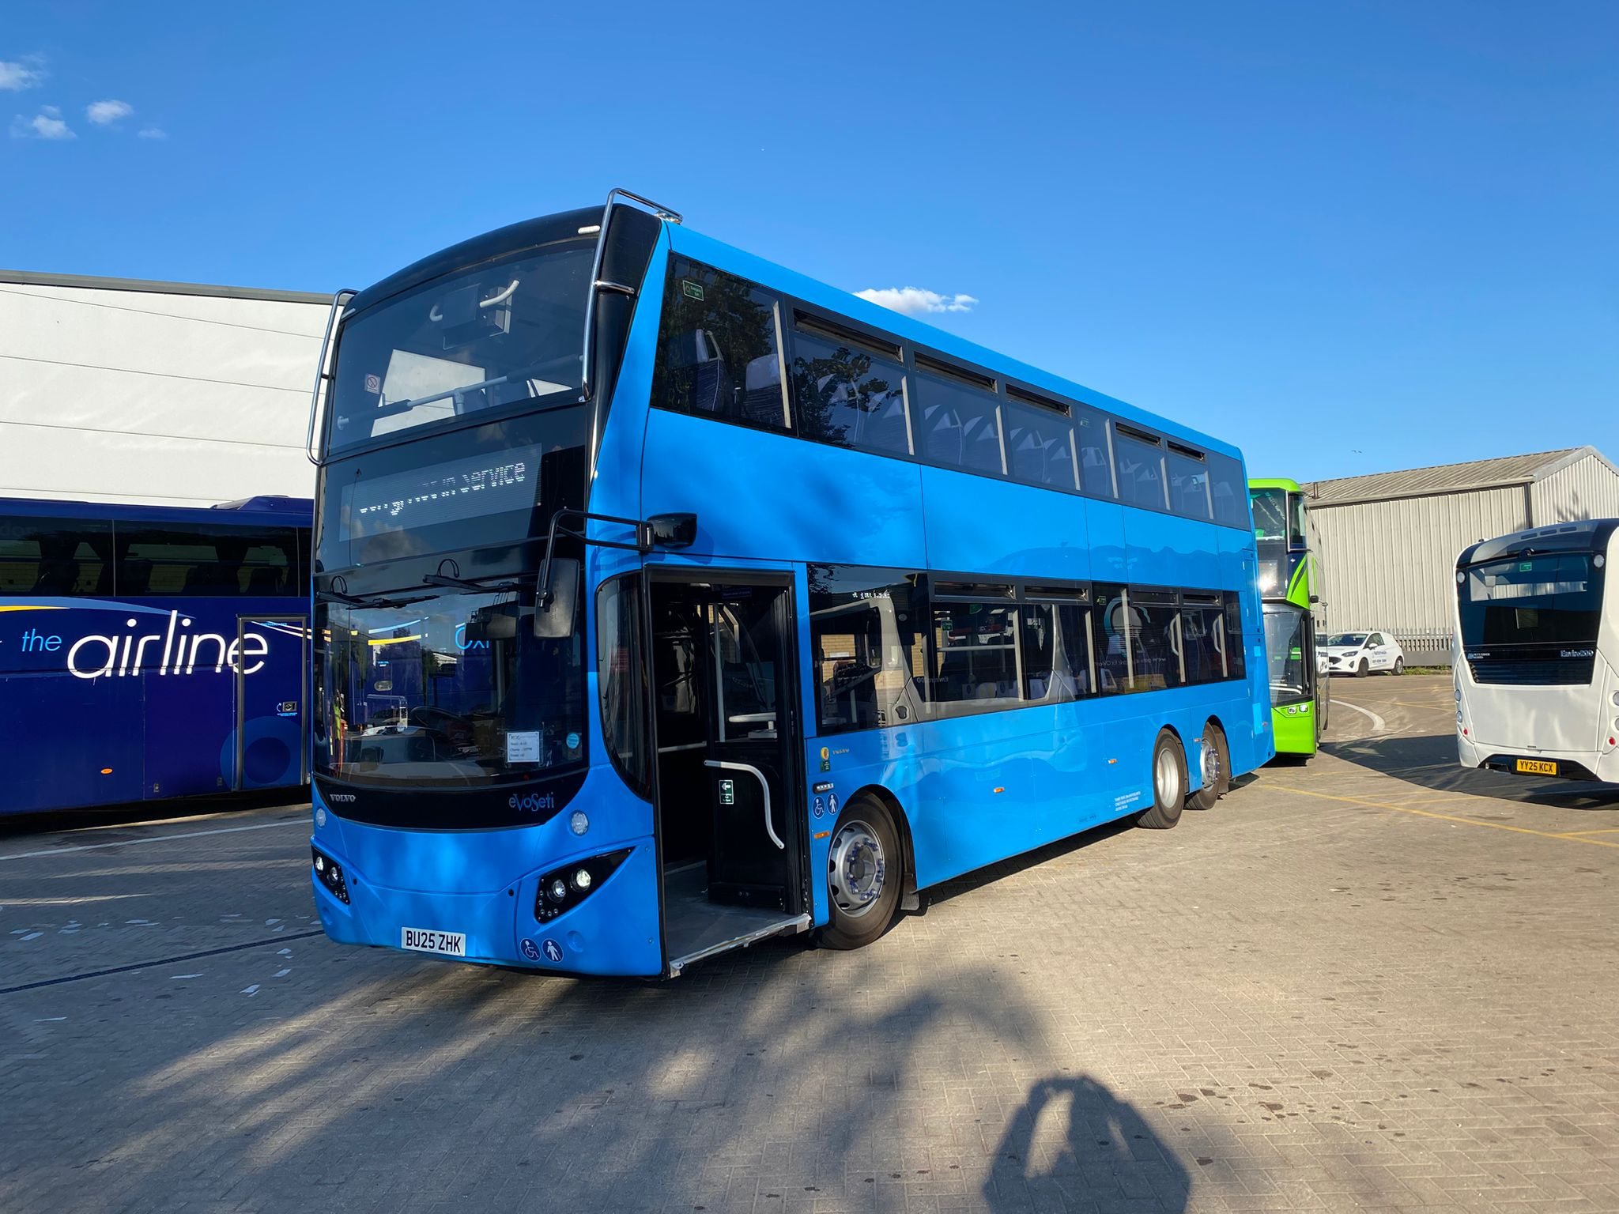
X40 service improvements
10 brand new tri-axle double deck buses
Improvement to every 20 mins on Mondays to Fridays and 30 mins on Sundays
Improved late night services from Oxford Fri/Sat
New late night services from Reading Fri/Sat
Route via Abingdon Road
BSIP-funded stops improvement south of Wallingford
Mobility hub development at Benson Marina
New right turn for buses at Benson Lane, Crowmarsh

Slide 9
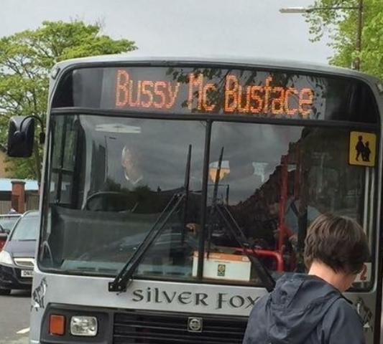
Questions?
Ed Webster
Public Transport Planner
edward.webster@oxfordshire.gov.uk

