Slide 1
Community Transport – More than a Bus
Yasmin Kaduji
Development Officer

Slide 2


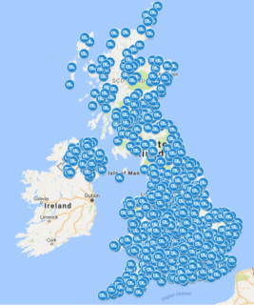
Our vision is of a world where everyone in their communities can access transport that meets their needs
CTA members in England carry over 13 million passenger annually, providing accessible transport options.
Our Movement
1300 Organisations and Operators across the UK, 900 in England
Our Support Offer
Provide 1-2-1 development support for members.
Operate as a designated body issuing section 19 permits
Create and collate research
Represent the sector at the national and regional level
Offer a telephone and email advice to the sector
Provide resources and templates for members
Our Membership
1300 across the UK 900 in England

Slide 3
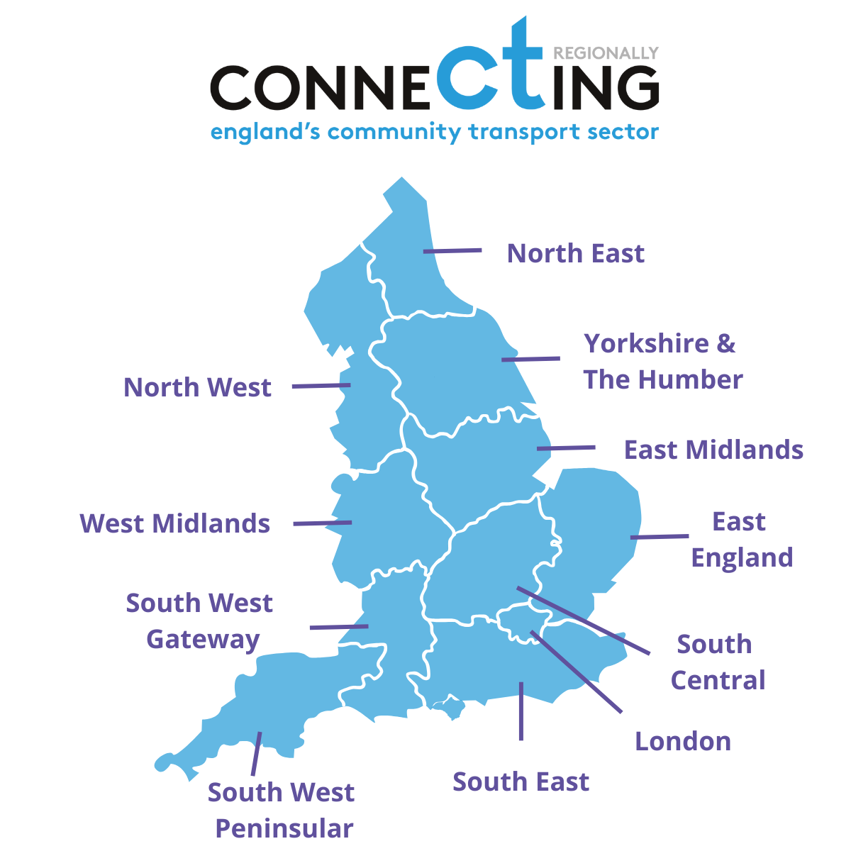
Development Support
There are 3 development officers in the England directorate at CTA.
They have areas of responsibility. The development officer for the
South Central area of England is
Yasmin Kaduji – Yasmin@ctauk.org
Development officers are there to work with you on a 1 to 1 basis, they can give you advice and help you to develop your organisation.

Slide 4
Community/Volunteer Car Schemes
Volunteers driving their own cars, paid a mileage allowance
Car Clubs – Shared Transport
Small Vehicle/MPV up to 8 Passenger seats
Can operate under a section 19 permit
Can be driven on a category B licence
Minibus – 9-16 passenger seats
Can operate under a section 19 permit or Section 22 permit
Driver must have a category D1 licence, can be a volunteer or paid
Volunteers can drive with a category B licence with restrictions
Group Hire
Local Community groups can hire the vehicle either with or without a driver
What is Community Transport?
Provides flexible and accessible community-led solutions in response to unmet local transport needs.
Often represents the only means of transport for many vulnerable and isolated people.
Typical services include, school transport, hospital transport, dial a ride and wheels to work
Most are demand responsive, but a growing number are scheduled services.
S19 membership can be flexible and open with no time constraint been registering and accessing transport

Slide 5
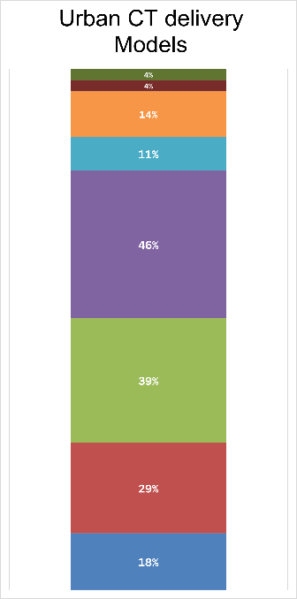
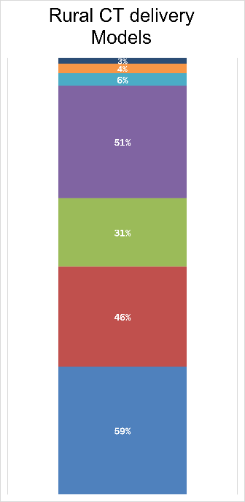
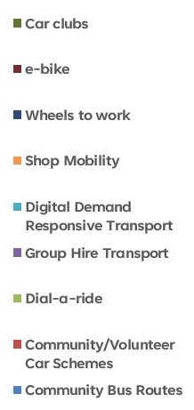
Delivery models Urban Vs Rural
What the data tells us
In rural areas CT is mainly delivered via community bus routes (59%)
and
community car schemes (46%)
Community buses are run when there is no or very limited public bus routes available.
This indicates in rural areas CT is a core and vital part of the transport network

Slide 6
Community Transport in Rural Areas compared to Urban
What the data tells us
In rural areas the main reasons for journeys is to support the community to access basic necessities
Shopping – 87%
Health appointment – 70%
Followed by the range of social trips
CT is twice as likely to be used for access to work than in urban areas.
Again showing that CT is a vital part of the transport network

Slide 7

Community Transport in Rural Areas compared to Urban
What the data tells us
Sustainable community transport in rural areas is much more reliant
on the ability to recruit and retain volunteers than urban areas.
Without the support from the local community this transport could be
at risk.
87% of rural areas utilise volunteer drivers
Compared to 81% in urban areas
Notes:
Our tackling loneliness data added to this and showed that in rural areas more men volunteer than urban areas 52% compared to 16% in urban
That in rural areas people volunteer less frequently but for more hours each time they volunteer

Slide 8
Community Transport in Rural Areas a Shared resource
What the data tells us
Just under half of community transport within rural areas operates across more than one local authority area compared to less than a third in urban areas
While this creates a challenge for community transport to work with and seek investment from each individual area it presents an opportunity for local authorities to work collaboratively and invest in CT in multiple areas
Community transport is a vital part of the transport system in rural areas collectively it can be invested in to ensure a sustainable future.
Notes:
Where they operate
Mainly Urban 17% Urban with Rural areas 48% Mainly Rural 41% Island 1% Costal 6%

Slide 9
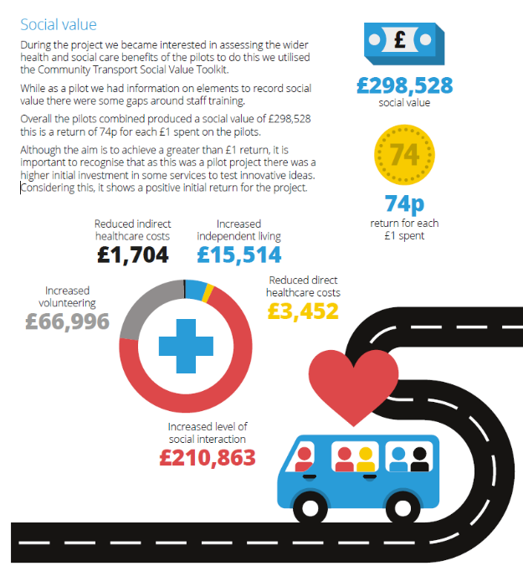

Impact of Community Transport
Social Value
Wider Benefits

Slide 10
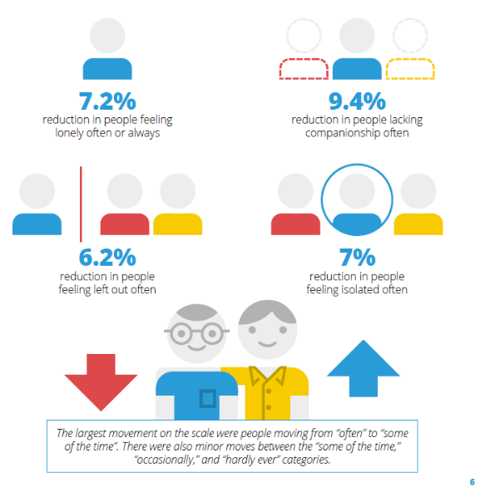
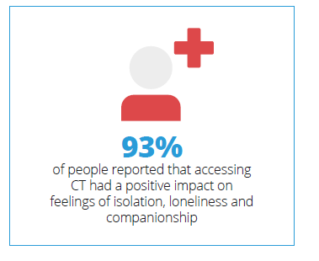
Impact of Community Transport
Creating connections and reducing loneliness

Slide 11
Opportunities for Town and Parish Councils
Challenges for Community Transport
Permit structure allows community bus and membership options – can be flexible for need
TCs could work collectively with CTO’s or develop solutions and have a stronger voice
Have trusted relationships with the community – This can be built on
Are able to leverage match funding to support sustainable transport
It’s more than a bus – can provide wider health and social care
Can be a long term partner
Driver shortage – current and future D1 Volunteer Recruitment
Funding and Commissioning – including capital for new vehicles
Relationships with Local Authority and Health system
Training and development of staff and volunteers – CT as a professional sector
Perceptions of the service – only for older people
Zero Emissions/decarbonisation –challenges on Infrastructure and vehicle cost and availability

Slide 12





Prioritising Deep Dive Areas
The focus will be to take a deep look at the key issues highlighted in the Mapping England Report.
Always building in the principles of working collaboratively within CT and with stakeholders and to share learning across England
The 5 Deep Dive areas are:
Accelerating EV Adoption: Insights and Strategies for Community Transport Operators in England
Maximising Impact: Evaluating the Value of Group Hire Services in Community Transport
Driving Sustainability: Evaluating and Future-Proofing Volunteer Car Schemes
Exploring and Enhancing Community Bus Routes: Understanding Operations, Challenges, and S22 Permit Usage
Connecting Community Transport to Local Devolution: Opportunities, Challenges, and Best Practices
Notes:
As a result of the key issues identified in the Mapping England: State of the Sector Community Transport Report 2024, we are moving away from holding 11 individual regional forums to focusing on 5 deep dive research areas. These areas will bring together multiple regions, enabling us to address the most pressing challenges highlighted in the report.
While the projects will focus on specific regions, the intended outcomes of working collaboratively with partners on these critical issues will remain central. This approach will allow for a deeper exploration of the sector’s needs and challenges, and we will share the learning and insights from each research area across all of England, ensuring a wider, national impact.
As we focus on the five deep dive areas in these projects, we will also continue to support individual Community Transport Organisations (CTOs) in their work with local authorities.
Our goal is to ensure that the national priorities are embedded within each of these research areas, aligning the projects with broader sector goals. By doing so, we aim to create a cohesive approach that not only addresses the specific challenges of each deep dive area but also supports the integration of national priorities, such as improving volunteer recruitment, promoting social value, and enhancing the role of community transport in local planning. This will ensure that CTOs are well-positioned to engage with local authorities effectively and contribute to long-term, sustainable solutions for community transport across the country.
The 5 deep dive areas are:
We will cover each one in a little more detail now.

Slide 13
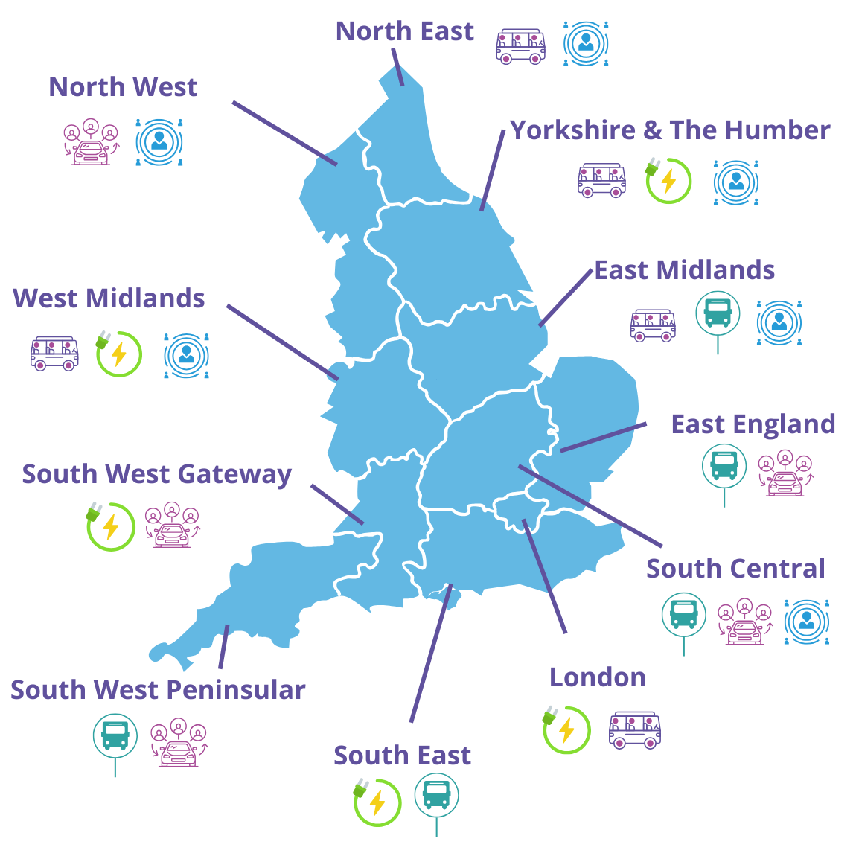
Regional Focus
Accelerating EV Adoption
Value of Group Hire Services
Future-Proofing Volunteer Car Schemes
Enhancing Community Bus Routes
Connecting CT to Local Devolution

Slide 14
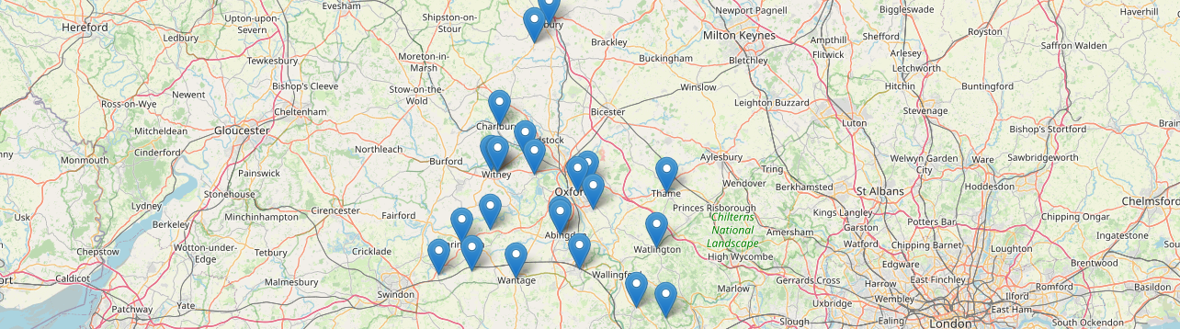
Community First Oxfordshire
Didcot Volunteer Drivers
Faringdon Community Bus
First and Last Mile CIC
Fish Volunteer Centre
Freeland Community Bus
Henley and District Handibus Scheme
Community First Oxfordshire
Thame Town Council
Villager Bus Services
Volunteer Link-up West Oxfordshire
Richard Wellesley Memorial Transport Group
CTA Members in Oxfordshire
Here’s just a few….

Slide 15

Upcoming events
England CT Conference
Tuesday 16th September
Community Building Session - Live Advice & Resources Explained
Members only Event
London (bookings open soon)
Wednesday 19th March – 11am-12pm - Online

